Slide 1
Parallel and Distributed Computing
Mr. Bikash Balami
TU, CDCSIT

Slide 2
Unit 1.1 :- PDC , A Perspective

Slide 3
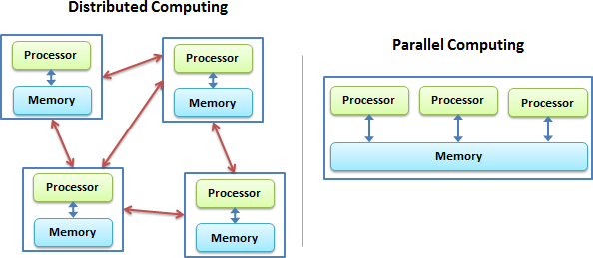
Introduction
In parallel computing, all processors may have access to a share memory to exchange information between processors
In distributed computing, each processor has its own private memory, where information is exchanged by passing message between processors (RPC, RMI)

Slide 4
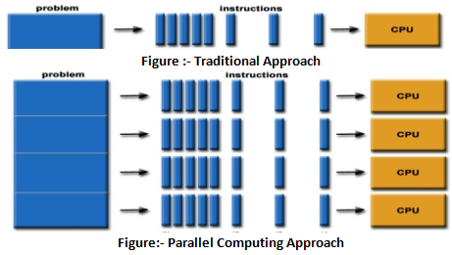
Why do we need parallel computing?
Serial computing is too slow
Need for more computing power (Eg:- Data mining, search engine, cryptography)

Slide 5
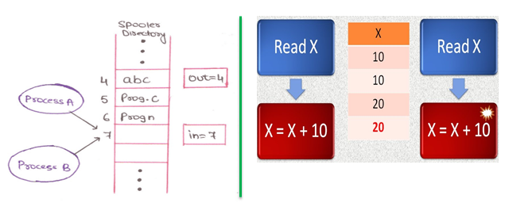
Issues on Shared Resources
Race Condition
P1
P2

Slide 6
How to avoid Race Condition?
Mutual Exclusion
Interrupt Disabling (Busy Wait)
Locked Variable (Busy Wait)
Strict Alternation (Busy Wait)
Sleep and Wake Up (Busy Wait Solution)

Slide 7
Parallel Processing Paradigms
Flynn’s Taxonomy
SISD (Single Instruction Single Data)
SIMD (Single Instruction Multiple Data)
MISD (Multiple Instruction Single Data)
MIMD (Multiple Instruction Multiple Data)

Slide 8
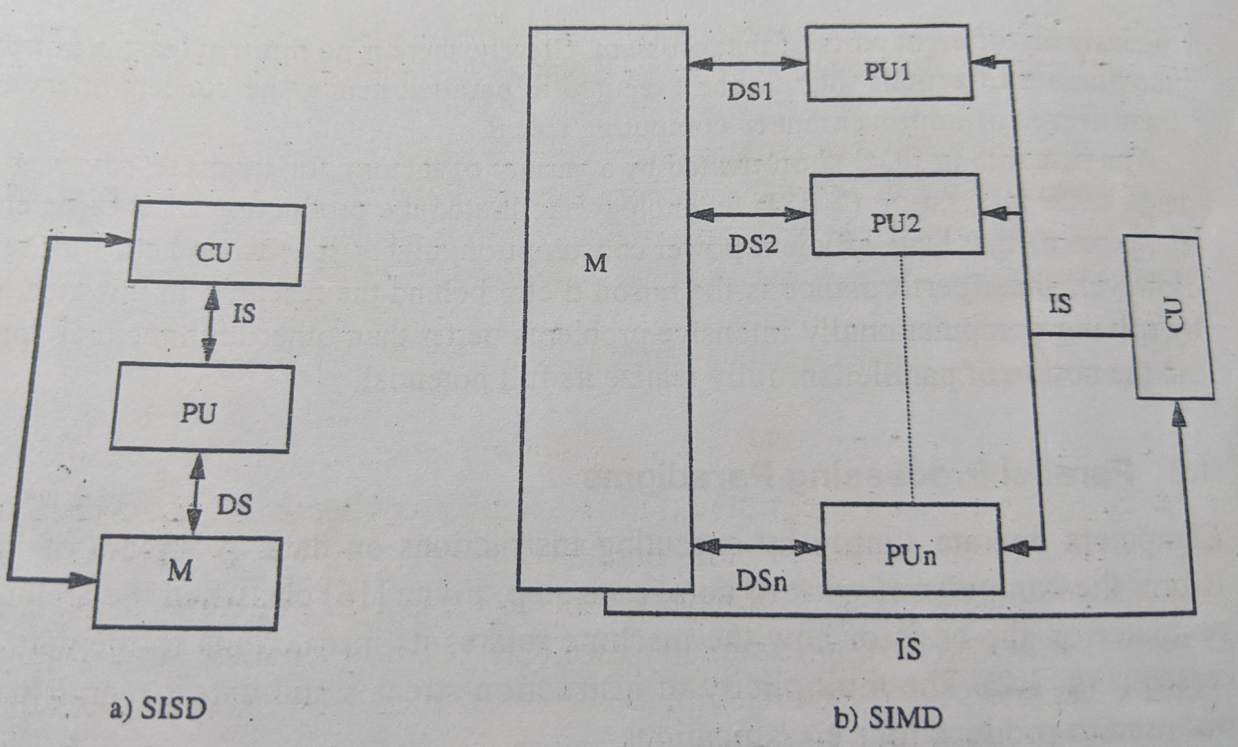
Parallel Processing Paradigms……

Slide 9
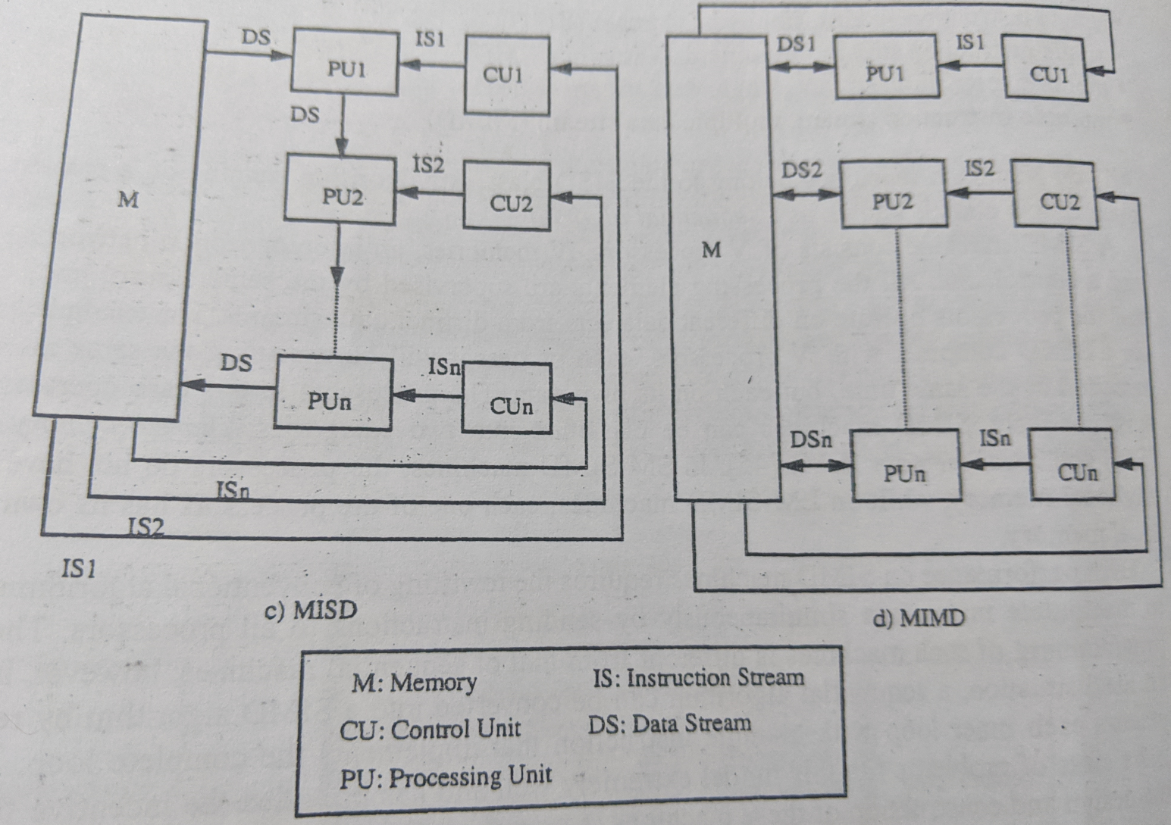
Parallel Processing Paradigms……

Slide 10
Issues
Issues related to parallelization that do not arise in sequential programming
Task Allocation
Proper sequencing of the tasks when some of them are dependent and cannot be executed simultaneously
Load balancing or Scheduling
Communication Time
Communication time between the processors
Serious when the number of processors increases to hundreds or thousands

Slide 11
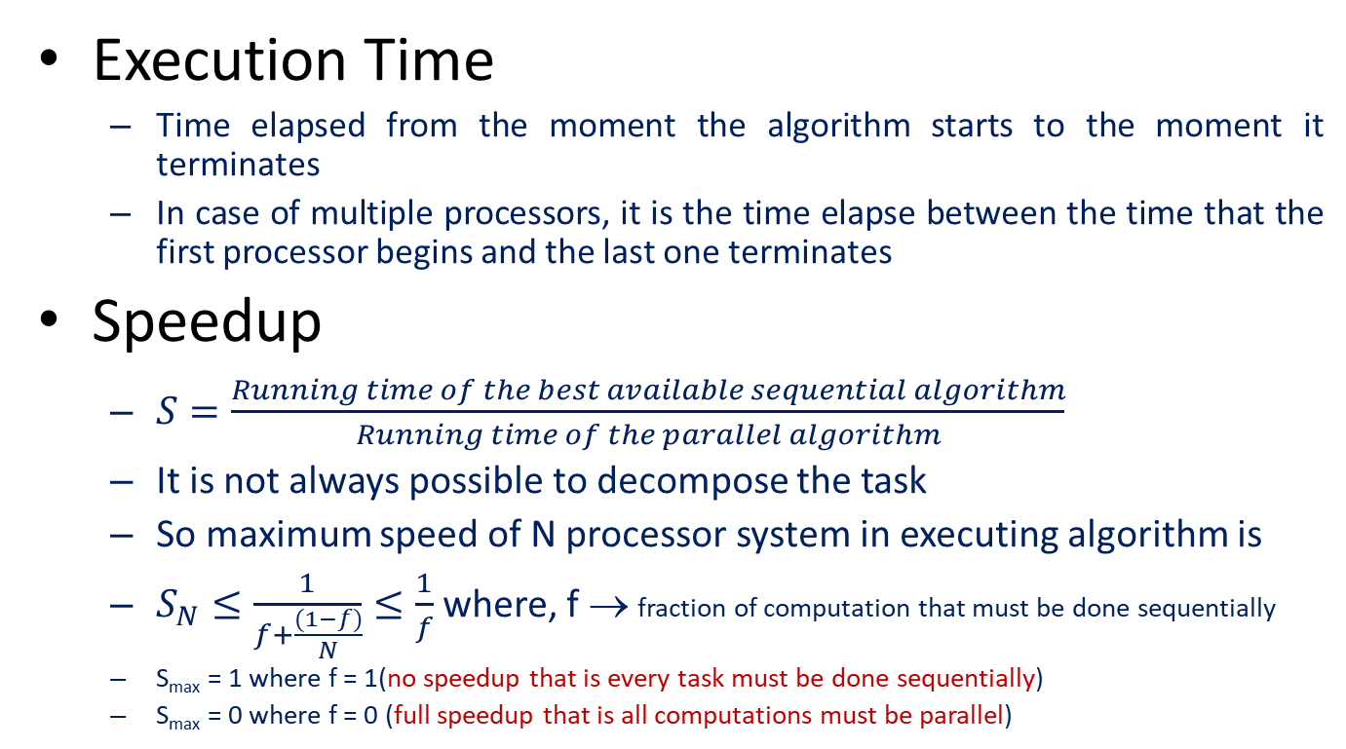
Performance Evaluation
Execution Time
Time elapsed from the moment the algorithm starts to the moment it terminates
In case of multiple processors, it is the time elapse between the time that the first processor begins and the last one terminates
Speedup
$S=\frac{Running time of the best available sequential algorithm}{Running time of the parallel algorithm}$
It is not always possible to decompose the task
So maximum speed of N processor system in executing algorithm is
$S_{N}≤\frac{1}{f+\frac{(1−f)}{N}}≤\frac{1}{f}$ where, f → fraction of computation that must be done sequentially
S_{max} = 1 where f = 1(no speedup that is every task must be done sequentially)
S_{max} = 0 where f = 0 (full speedup that is all computations must be parallel)

Slide 12
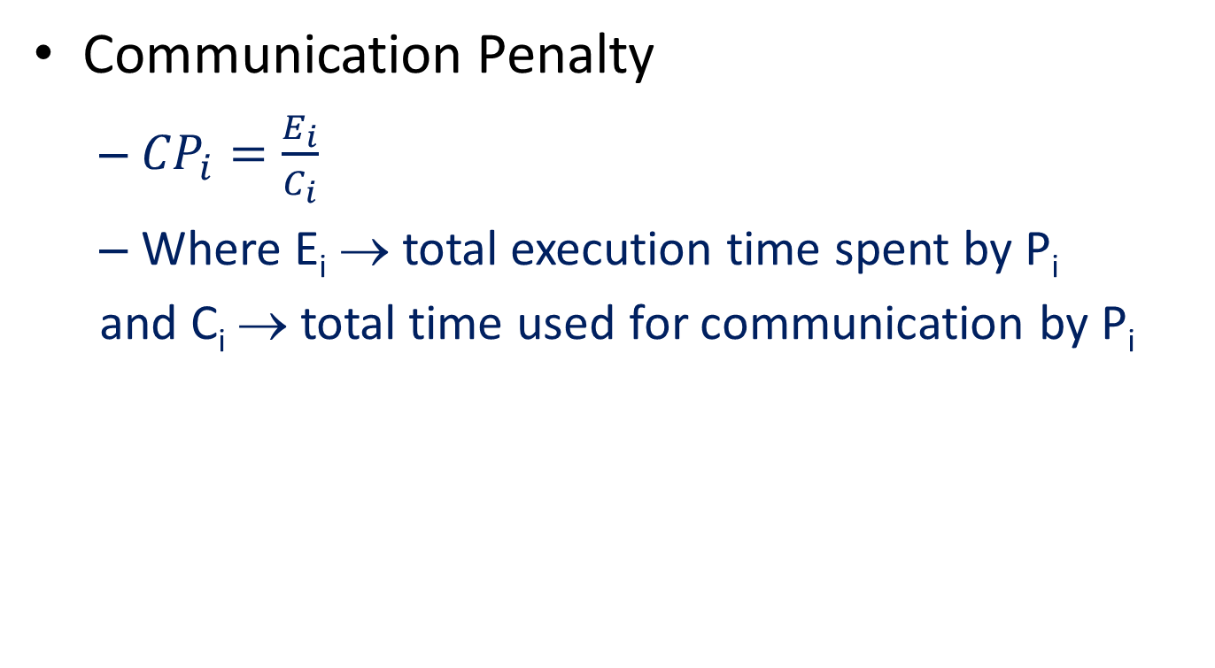
Performance Evaluation……………….
Communication Penalty
${CP}_{i}=\frac{E_{i}}{C_{i}}$
Where E_{i} → total execution time spent by P_{i}
and C_{i} → total time used for communication by P_{i}

Slide 13
End of Session Unit 1.1

Slide 14
Unit 1.2 :- Semantics of Concurrent Programming

Slide 15
Introduction
Concurrent programming refers activation of more than one instructions at a time
In programing language theory, semantics is the field of concerned with the mathematical study of the meaning of the programming language
Syntactic structure VS Semantic structure
English Language
S + V + O (Grammatical pattern but language dependent)
Example
I eat rice. (Syntactically correct and semantically correct)
I rice eat. (Syntactically wrong)
I eat car. (Syntactically correct but semantically wrong)
Programming Language
CFG (Context Free Grammar)
Declaration → Type Variable
Type → int
Example
int a, a = 2;
int b, b = 3.1 (semantically wrong)

Slide 16
Categories
Axiomatic Semantic Definition
Operational Semantic Definition
Denotational Semantic Definition

Slide 17
Models of Concurrent Programming
Level of Granularity
Consider two agents (eg bank teller)are accessing a centralized database simultaneously
Observe these activities at (deposit = 100)
Transaction Level
CPU Cycle Level
Sharing the Clock
When several processes operate concurrently, it is important to determine whether they share the same clock (30 8:30) p1 , p2 is dependent on p1
Sharing the Memory
Access to share memory may have to be mutually exclusive
Pattern of Interaction
Synchronization (defines a chronological order between events)
Mutual Exclusion
Mutual Admission
Communication (defines a transfer of information)
Synchronous Communication ( All parties involved in the communication are present at the same time Eg :- Phone Calling)
Asynchronous Communication ( doesn’t requires that all parties involved in the communication to be present at the same time Eh:- E-mail)

Slide 18
Mutual Exclusion
Sequence of actions where execution is individual
No two processes are in their critical section
Once a process starts executing the sequence of actions whose execution us indivisible, it may not be interrupted until the sequence is completed
Busy wait VS Sleep and Wakeup
Why Mutual Exclusion
Process P1 Process P2
a = getchar() -------------
------------- -------------
------------- a = getchar()
------------- a = b
b = a -------------
putchar(b) -------------
------------- putchar(b)
Here a is shared variable
The value that P1 has read is lost

Slide 19
Mutual Admission
Sequence of actions which must be executed by two processes simultaneously
If one process is ready and the other is not, it must wait until both are ready
Eg:-
Message Passing
Sender (Destination, Message)
Receiver (Source, Message)
Sender and Receiver must be ready for the transfer to occur
Both may proceed independently afterwards

Slide 20
Axiomatic Semantic Definition
Defines the meaning of language construct by making statements in the form of axioms or inference rules
Based on the Hoare’s program (Hoare Triple), which in the form,
{P} S {Q}, where P → Pre – Condition
Q → Post – Condition
S → Statement
If S statement is executed in state where P holds, then it terminates and Q holds
Pre – Condition describes the state of the program before execution (Like INPUT)
Post – Condition defines the state after the execution (Like OUTPUT)
Here P and Q are predicates that holds Boolean value either TRUE or FALSE

Slide 21
Axiomatic Semantic Definition…….
Example
{x = 5} x = x + 1 {x = 6}
P S Q
TRUE After Execution Must Be TRUE
{j = 3 AND k = 4} j = j + k {j=7 AND k = 4}
{x ≥ 0} while (x ≠ 0) do x = x – 1 {x = 0}
{x<0} while (x ≠ 0) do x = x – 1 infinite {x = 0}
P ∧ S terminates → Q (after code run)

Slide 22
Axiomatic Semantic Definition…….
Example
{x = x + 1} x ≤ N
?
x + 1 ≤ N

Slide 23
Axiomatic Semantic Definition…….
Partial Correctness
A program is partially correct with respect to pre condition an post condition, provided that if the program is started with the values that makes the pre condition true, the resulting value make the post condition true, when the program halts (if ever)
i.e. if answer is returned, it will be correct
Total Correctness
The program terminates when started with values satisfying the pre condition, the program is called totally correct
i.e. it requires that the algorithm terminates

Slide 24

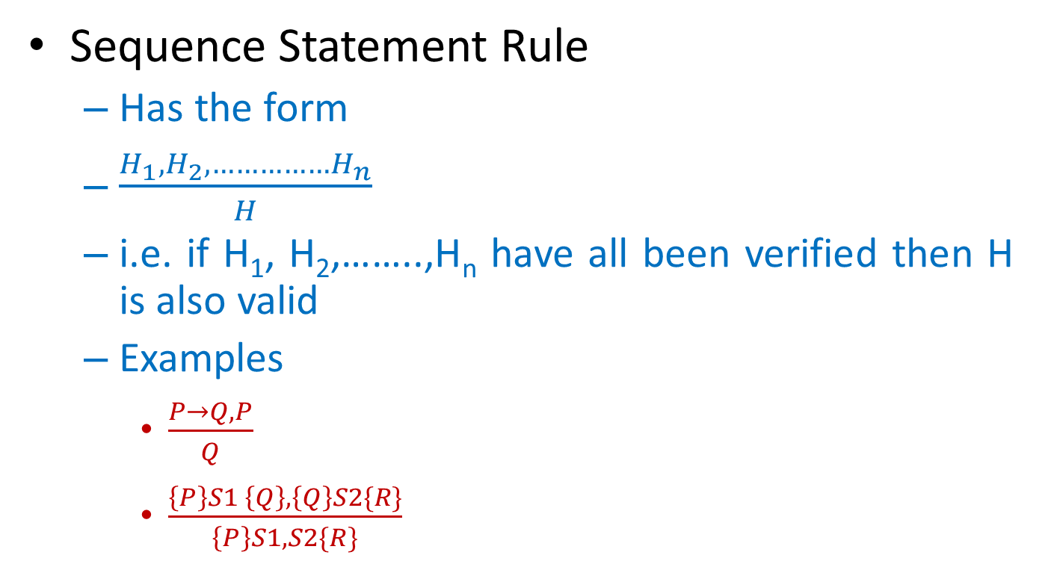
Axiomatic Semantic Definition…….
Sequence Statement Rule
Has the form
$\frac{H_{1},H_{2}, ……………H_{n}}{H}$
i.e. if H₁, H₂,……..,H_{n} have all been verified then H is also valid
Examples
$\frac{P→Q, P}{Q}$
$\frac{\left\{P\right\}S1 \left\{Q\right\}, \left\{Q\right\}S2\{R\}}{\left\{P\right\}S1,S2\{R\}}$

Slide 25

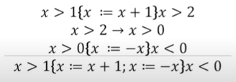
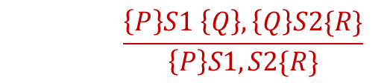
Axiomatic Semantic Definition…….
$$\frac{\left\{P\right\}S1 \left\{Q\right\}, \left\{Q\right\}S2\{R\}}{\left\{P\right\}S1,S2\{R\}}$$

Slide 26

Axiomatic Semantic Definition…….
Alternation Statement Rule
IF –THEN
{P and B} S {Q} P if(con) {s1} else s2.Q
{P and NOT B} ⊃ {Q}
∴{P} IF B THEN S END IF {Q}
IF – ELSE
{P and B} S1 {Q}
{P and NOT B} S2 {Q}
∴{P} IF B THEN S1 ELSE S2 END IF {Q}

Slide 27
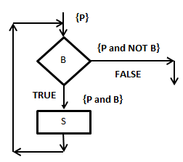

Axiomatic Semantic Definition…….
LOOP
WHILE
$\frac{\left\{P and B\right\}S \{P\}}{∴\left\{P\right\}while B do S END while \{P and NOT B\}}$

Slide 28

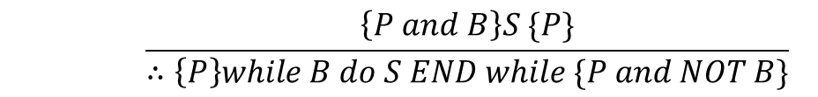
Axiomatic Semantic Definition…….
LOOP (Example)
$$\frac{\left\{P and B\right\}S \{P\}}{∴\left\{P\right\}while B do S END while \{P and NOT B\}}$$
X = 10…… x>=10

Slide 29
Axiomatic Semantic Definition…….
Disjoint Parallel Program
Two programs S₁ and S₂ are said to be disjoint if none of them can change the variables accessed by the other
Denoted as [S₁ ⎥⎥ S₂]
Example
S₁ : x = z S₁: x = y + 1
S₂ : y = z S₂: x = z
Semantics of this statement can be denoted as
{P₁} S₁ {Q₁}
{P₂} S₂ {Q₂}
∴{P₁ and P₂} [S₁ || S₂] {Q₁ and Q₂}
BUT NOT

Slide 30
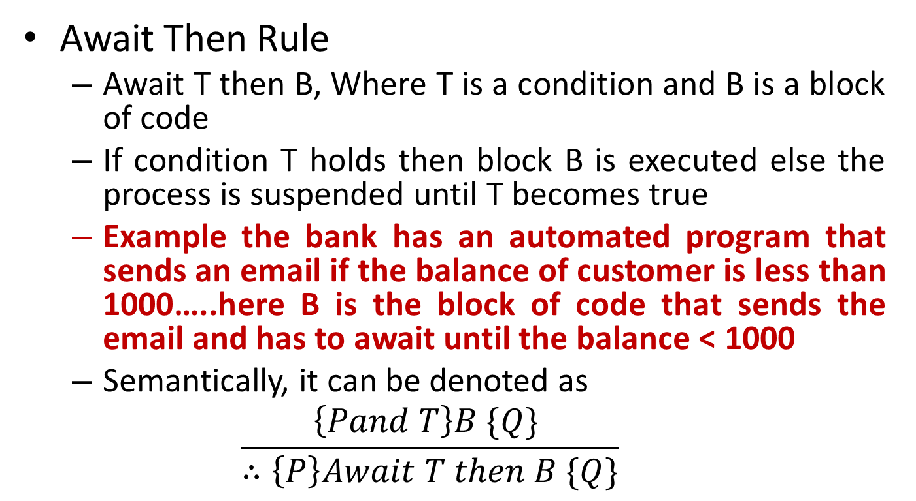
Axiomatic Semantic Definition…….
Await Then Rule
Await T then B, Where T is a condition and B is a block of code
If condition T holds then block B is executed else the process is suspended until T becomes true
Example the bank has an automated program that sends an email if the balance of customer is less than 1000…..here B is the block of code that sends the email and has to await until the balance < 1000
Semantically, it can be denoted as
$$\frac{\left\{Pand T\right\}B \{Q\} }{∴\left\{P\right\}Await T then B \{Q\}}$$

Slide 31
Operational Semantics
Focuses on how the state of the program is affected
i.e. how a computation is performed
Meanings for program phrases defined in terms of the steps of computation they can take during program execution
Example
To execute x = y, first determine the value of y, and assign it to x
Uses the notation <P, S>, means semantics of program P at state S
Example
< z=x, x=y, y=z, [x→5, y→7, z→0]> ⇒ <P1, S1>
<x=y, y=z,[x→5, y→7, z→5]> ⇒ <P2, S2>
<y=z, [x→7, y→7, z→5]> ⇒
< , [x→7, y→5, z→5]>

Slide 32
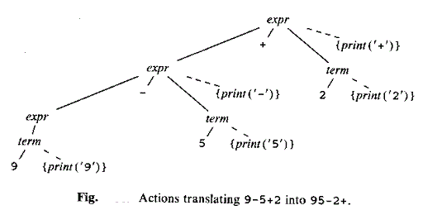
Operational Semantics……………....
So before starting the program, the state of the memory is [x→5, y→7, z→0], and after the program has terminated, it is [x→7, y→5, z→5], which is meaning of the program z=x, x=y, y=z in the state [x→5, y→7, z→0]
Syntax directed translation can also be represented as operational semantics
Eg
Production Semantic Rules
expr→expr + term {print (‘+’)}
expr→expr - term {print (‘-’)}
expr→term
term→0 {print (‘0’)}
term→1 {print (‘1’)}
…………... ……………….
term→9 {print (‘9’)}

Slide 33
Operational Semantics……………....
Hennessy Milner Logic
Used to specify properties of a labeled transition system
Introduced by Mathew Hennessy and Rabin Milner
Syntax
φ → tt {always true}
φ → ff {always false}
φ → φ₁ ∧ φ ₂ {conjunction}
φ → φ₁ ∨ φ ₂ {disjunction}
φ → [L] φ {after every execution of event L, the result has property φ}
φ →<L> φ {if there exists an event L such that after its execution the result has property φ }
Example
E → <tick> tt {E can do a tick}
E → [tick] tt {E always tick}
E → [tick] ff {E can not do the tick}
E → <tick> ff {????????????????}

Slide 34
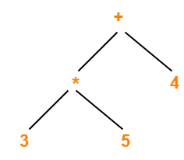
Denotational Semantic Definitions
Each construct of the language is mapped into a mathematical object that defines its meaning
Idea of denotational semantics is to associate an appropriate mathematical object with each phrase of the language
Example
Syntax tree for 3*5+4

Slide 35
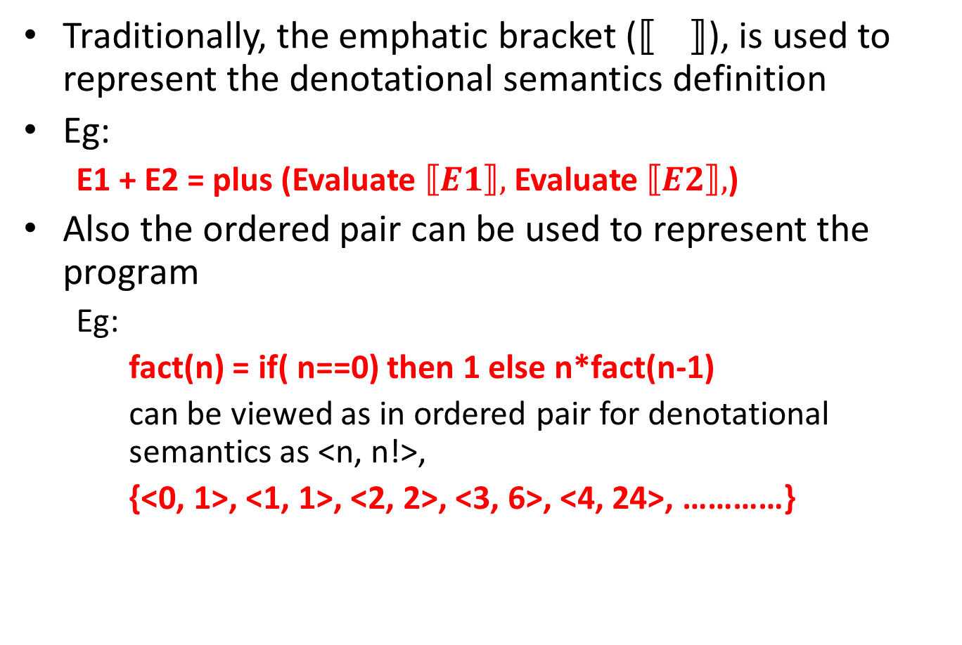
Denotational Semantic Definitions……
Traditionally, the emphatic bracket (), is used to represent the denotational semantics definition
Eg:
E1 + E2 = plus (Evaluate $⟦E1⟧,$ Evaluate $⟦E2⟧,$)
Also the ordered pair can be used to represent the program
Eg:
fact(n) = if( n==0) then 1 else n*fact(n-1)
can be viewed as in ordered pair for denotational semantics as <n, n!>,
{<0, 1>, <1, 1>, <2, 2>, <3, 6>, <4, 24>, …………}

Slide 36
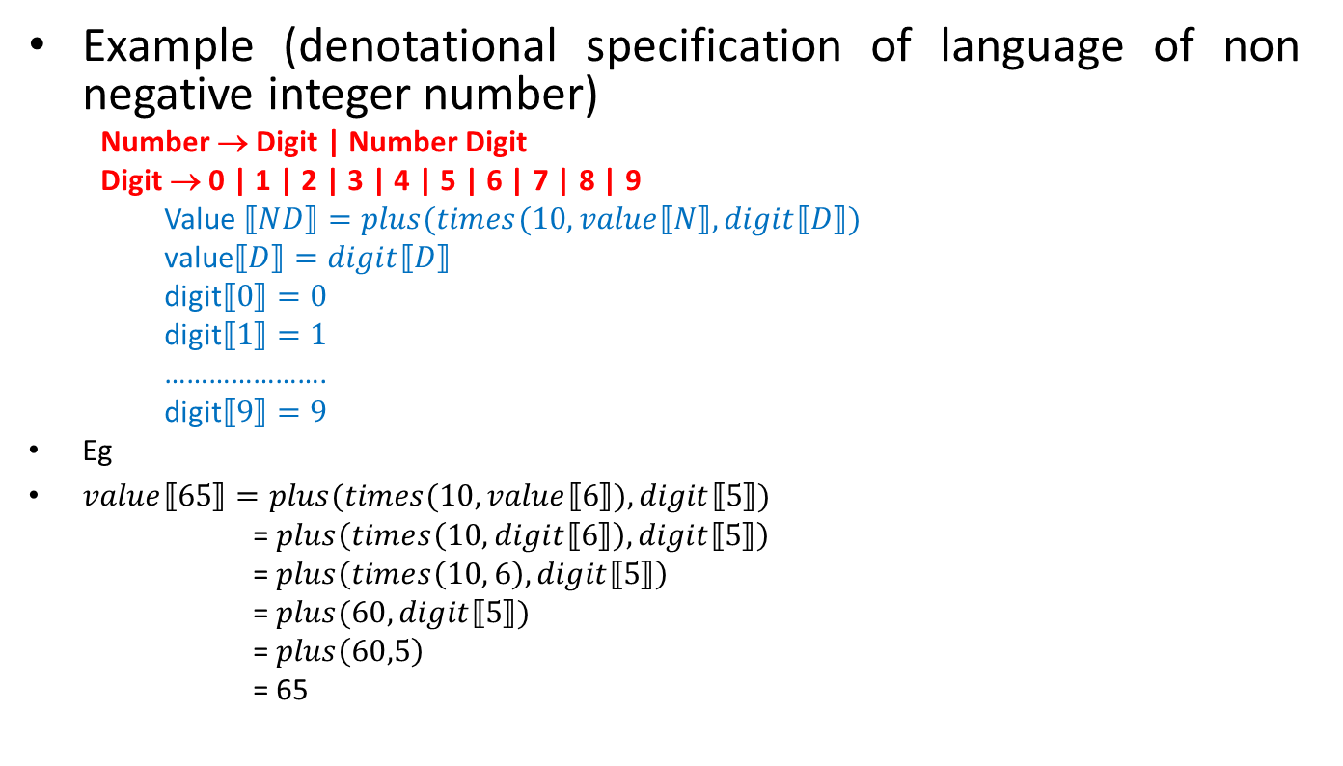
Denotational Semantic Definitions……
Example (denotational specification of language of non negative integer number)
Number → Digit | Number Digit
Digit → 0 | 1 | 2 | 3 | 4 | 5 | 6 | 7 | 8 | 9
Value $⟦ND⟧=plus(times(10,value⟦N⟧, digit⟦D⟧)$
value$⟦D⟧=digit⟦D⟧$
digit$⟦0⟧=0$
digit$⟦1⟧=1$
………………….
digit$⟦9⟧=9$
Eg
$value⟦65⟧=plus(times(10,value⟦6⟧),digit⟦5⟧)$
= $plus\left(times\left(10,digit⟦6⟧\right),digit⟦5⟧\right)$
= $plus\left(times\left(10, 6\right),digit⟦5⟧\right)$
= $plus(60,digit⟦5⟧)$
= $plus\left(60,5\right)$
= 65

Slide 37
Denotational Semantic Definitions……
Communicating Sequential Process
Concurrent systems are made up of processes where each process is defined by a sequence of events
A process P can be represented by the notation
x → Q, where x is an event and Q is a process
i.e. P as a process which first engages in the event x then behaves exactly as described by Q
Each process is defined with a particular alphabet which represent the event
Small letter (alphabet, i.e. set of events), capital letter (Process)
It is logically impossible for an alphabet to engage an event outside an alphabet
i.e. a machine designed to sell chocolate cannot deliver toy

Slide 38
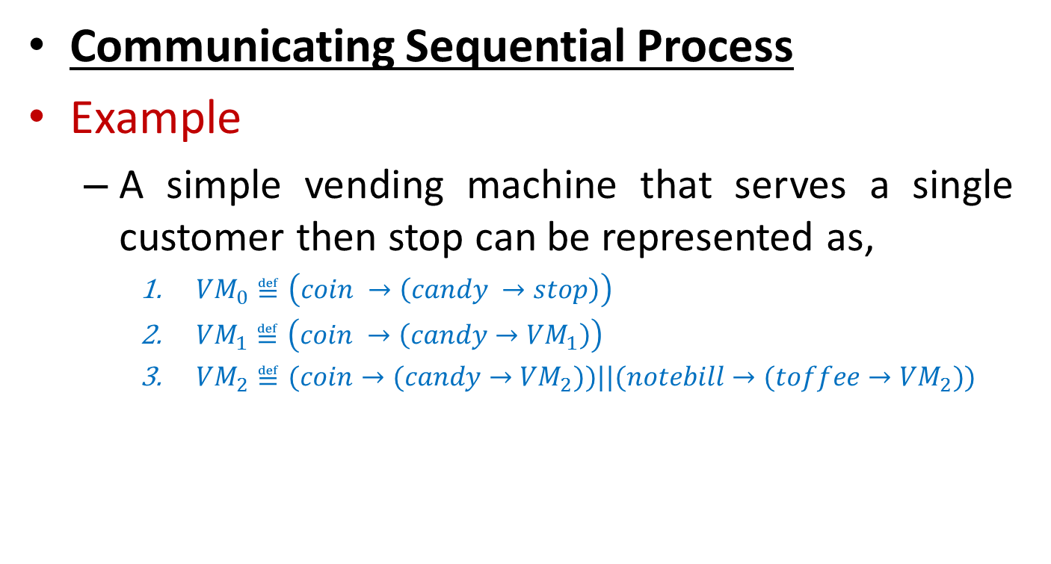
Denotational Semantic Definitions……
Communicating Sequential Process
Example
A simple vending machine that serves a single customer then stop can be represented as,
${VM}_{0}≝\left(coin →\left(candy →stop\right)\right)$
${VM}_{1}≝\left(coin →\left(candy→{VM}_{1}\right)\right)$
${VM}_{2}≝(coin→(candy→{VM}_{2}))||(notebill→(toffee→{VM}_{2}))$

Slide 39
End of Session Unit 1.2

Slide 40
Unit 1.3 :- Process Algebra

Slide 41

Process Algebra
System behavior generally consists of process and data
Process are the control mechanism for the manipulation of the data
Process are dynamic and active, while the data are static and passive
System behavior tends to be composed of several processes that are executed concurrently, where those processes exchange data in order to influence each other’s behavior

Slide 42

Process Algebra……………………………
Example
DFA (Deterministic Finite Automata)
1(0 + 1)*0 → Process Algebra
Process Graph

Slide 43
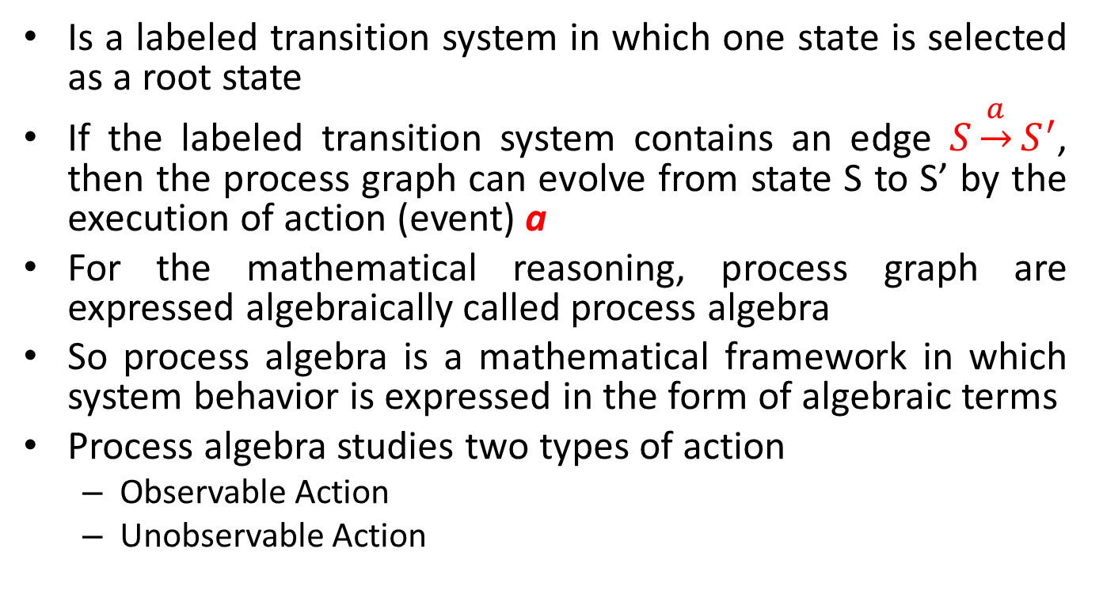
Process Algebra……………………………
Is a labeled transition system in which one state is selected as a root state
If the labeled transition system contains an edge $S\underset{→}{a}S^{′}$, then the process graph can evolve from state S to S’ by the execution of action (event) a
For the mathematical reasoning, process graph are expressed algebraically called process algebra
So process algebra is a mathematical framework in which system behavior is expressed in the form of algebraic terms
Process algebra studies two types of action
Observable Action
Unobservable Action

Slide 44
Process Algebra……………………………
Observable Action
Can occur within a process, if the process is ready to perform the action and some controlling environments allows it to occur
Explicit
Unobservable Action
Occur without any event (explicit)
Implicit
Denoted by τ (tow)

Slide 45
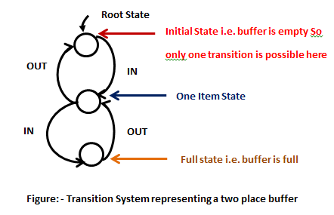
Process Algebra……………………………
Example memory = 2items q0, q1(1+1), q2(2-1)
The buffer is operated through
a two place buffer
IN → putting one item in the buffer
OUT → taking one item from the
buffer
It is impossible to put one item
into a full buffer and impossible
to take one item from empty buffer
Initially buffer is empty, i.e. only one operation (IN) is possible

Slide 46
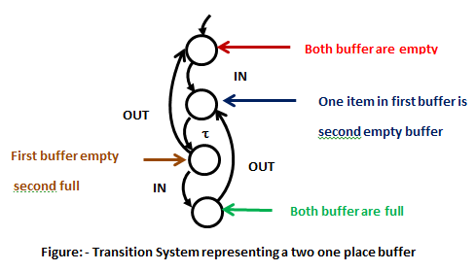
Process Algebra……………………………
Example m1 (1), m2(1) int a[2] first int b[1],c[1] second
Q0 b-emp c-emp
Q1 b-ful c-emp
Q2 b-em c-ful
Q3 b-ful c-full

Slide 47
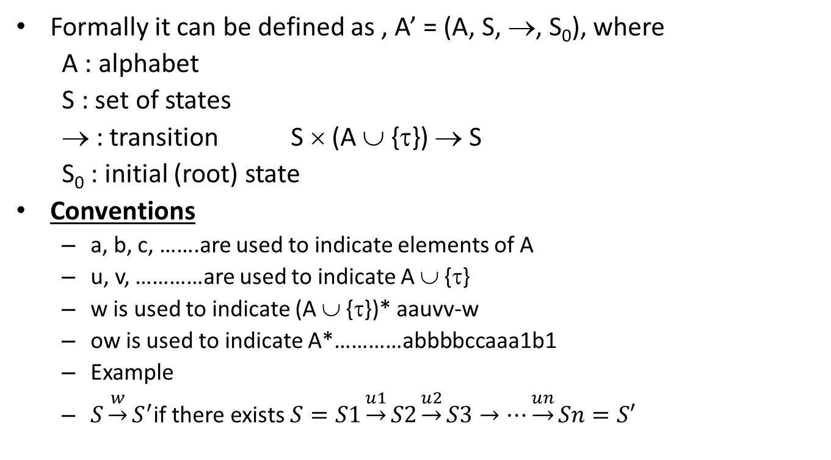
Transition System
Formally it can be defined as , A’ = (A, S, →, S₀), where
A : alphabet
S : set of states
→ : transition S × (A ∪ {τ}) → S
S₀ : initial (root) state
Conventions
a, b, c, …….are used to indicate elements of A
u, v, …………are used to indicate A ∪ {τ}
w is used to indicate (A ∪ {τ})* aauvv-w
ow is used to indicate A*…………abbbbccaaa1b1
Example
$S\underset{→}{w}S^{′}$if there exists $S=S1\underset{→}{u1}S2\underset{→}{u2}S3→…\underset{→}{un}Sn=S′$

Slide 48
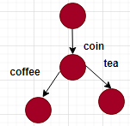
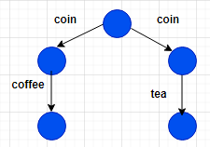
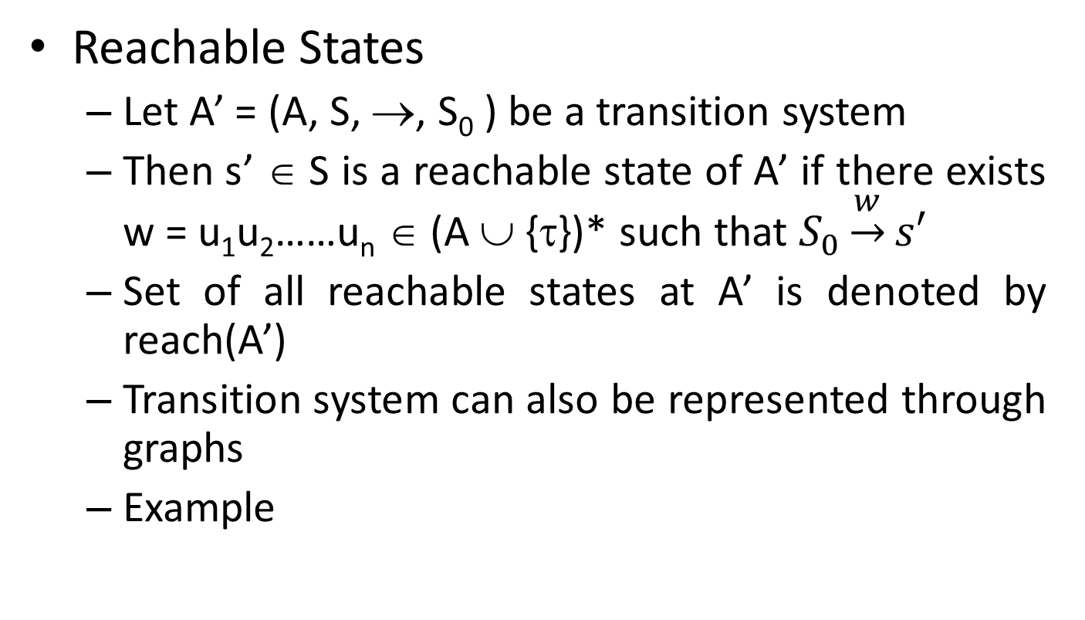
Transition System……………………….......
Reachable States
Let A’ = (A, S, →, S₀ ) be a transition system
Then s’ ∈ S is a reachable state of A’ if there exists w = u₁u₂……u_{n} ∈ (A ∪ {τ})* such that $S_{0}\underset{→}{w}s′$
Set of all reachable states at A’ is denoted by reach(A’)
Transition system can also be represented through graphs
Example

Slide 49
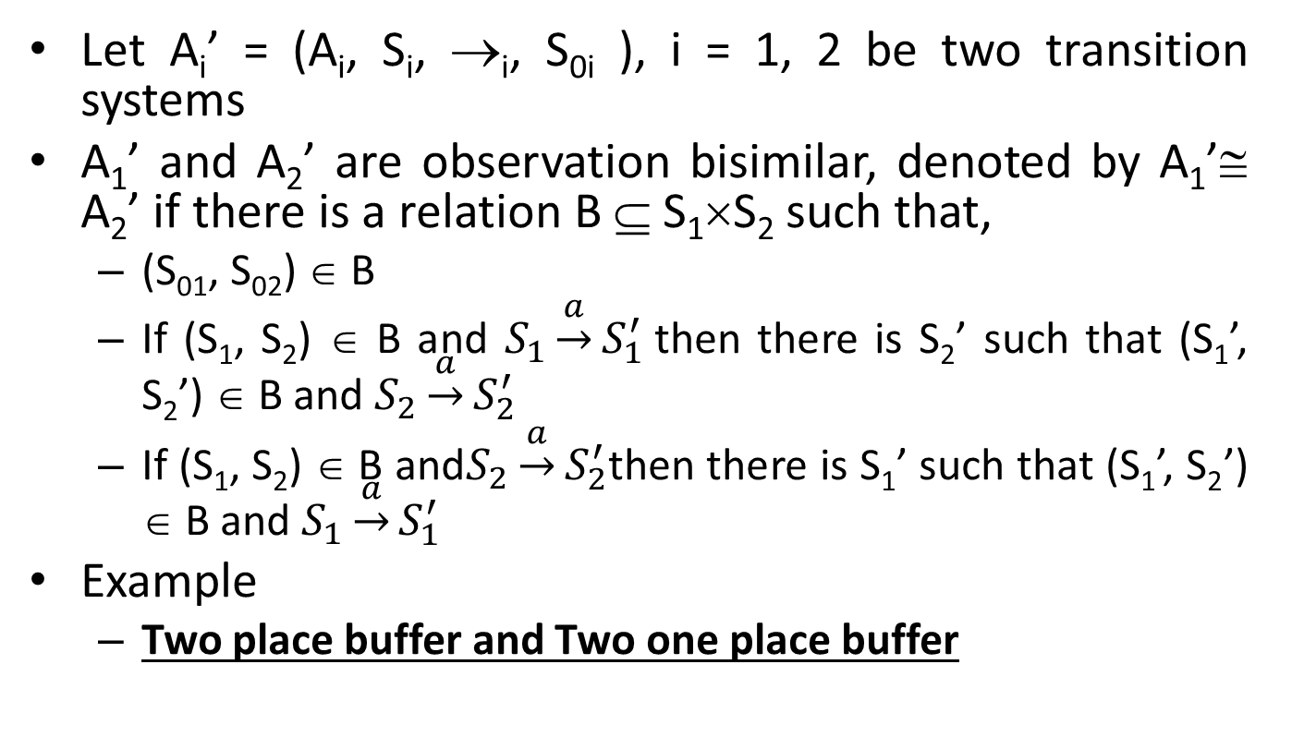
Observation Bisimilarity
Let A_{i}’ = (A_{i}, S_{i}, →_{i}, S_{0i} ), i = 1, 2 be two transition systems
A₁’ and A₂’ are observation bisimilar, denoted by A₁’≅ A₂’ if there is a relation B ⊆ S₁×S₂ such that,
(S₀₁, S₀₂) ∈ B
If (S₁, S₂) ∈ B and $S_{1}\underset{→}{a}S_{1}^{′}$then there is S₂’ such that (S₁’, S₂’) ∈ B and $S_{2}\underset{→}{a}S_{2}^{′}$
If (S₁, S₂) ∈ B and$S_{2}\underset{→}{a}S_{2}^{′}$then there is S₁’ such that (S₁’, S₂’) ∈ B and $S_{1}\underset{→}{a}S_{1}^{′}$
Example
Two place buffer and Two one place buffer

Slide 50
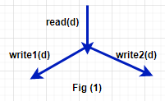
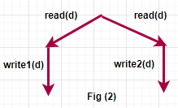
Observation Bisimilarity………………
Example
Consider the following two processes
In fig(1), the process read the datum d and decides whether to write d on disc 1 or disc 2
In fig(2), the process determines whether to write either on disc 1 or disc 2, before reading the datum d
Both processes display the same string and actions
i.e. read(d)write1(d) OR read(d) and write2(d)

Slide 51
Observation Bisimilarity………………
Example
Here they are traced equivalent but not are bisimilar because
In fig(1), in case of crash of disc 1 after executing read(d) and write1(d), there is a second chance to write on disc 2 using write2(d)
But in fig(2), in case the disc 1 crashed after executing read(d) and write1(d) then it doesn’t have any option to write the datum

Slide 52
Process Terms
Let act be defined as A ∪ {τ}
The set of process terms, proc, whose element will be denoted by P, Q, R and are described as
P → a.P (Prefix) ⇒ denotes a process that behaves like P after executing event a
P → stop{A} (Deadlock) ⇒ denotes a process which doesn’t perform any action
P → P + Q (Choice) ⇒ denotes a process that behaves like either P or Q
P → P || Q (Parallelism) ⇒ where P and Q run independently
P → P [a | b] (Renaming) ⇒ denotes a process that behave like P and when it executes b, P executes a
P → P | {b} (Restriction) ⇒ is the process without action b

Slide 53
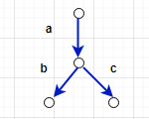
Process Terms……………………………
Example
S = a.{b. stop{a,b,c} + c.stop{a,b,c}}

Slide 54
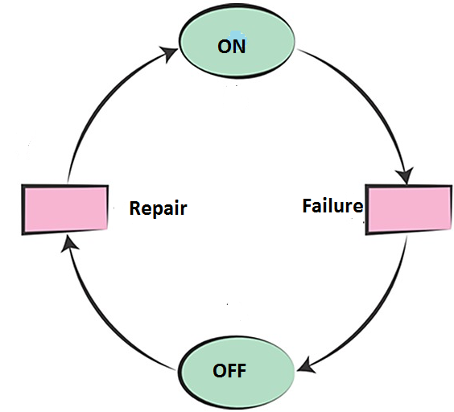
Petri Nets
Developed by Carl Adam Petri in 1962 as his PhD research
Is the mathematical modeling language for the description of the system
i.e. used to model the functionality behavior of the system
Abstract model of information flow

Slide 55
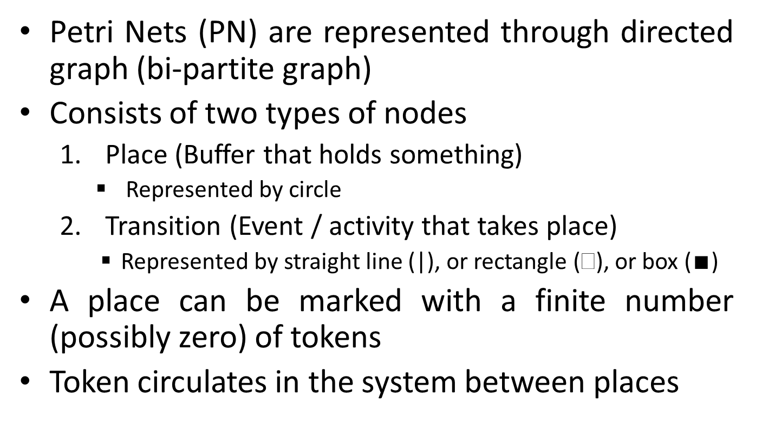
Petri Nets……………………………………...
Petri Nets (PN) are represented through directed graph (bi-partite graph)
Consists of two types of nodes
Place (Buffer that holds something)
Represented by circle
Transition (Event / activity that takes place)
Represented by straight line (|), or rectangle (), or box ($∎$)
A place can be marked with a finite number (possibly zero) of tokens
Token circulates in the system between places

Slide 56
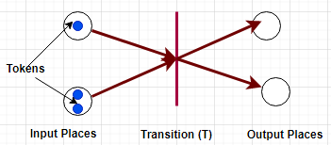
Petri Nets……………………………………..
A transition is called enabled, if for every arc from a place P to transition T, there exists a distinct token in the marking
i.e. a transition is fired whenever there is at least one token in all the input places
When it is fired, one token (by default) is removed from all the input places and one token is added to all its output places

Slide 57
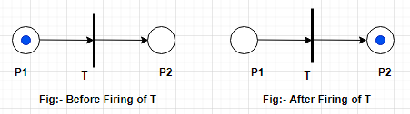
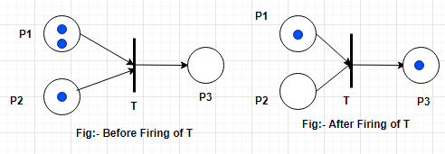
Petri Nets……………………………………..
Input Places → Pre condition
Output Places → Post condition
Example 1
Example 2
2
3
3
6
4
add

Slide 58
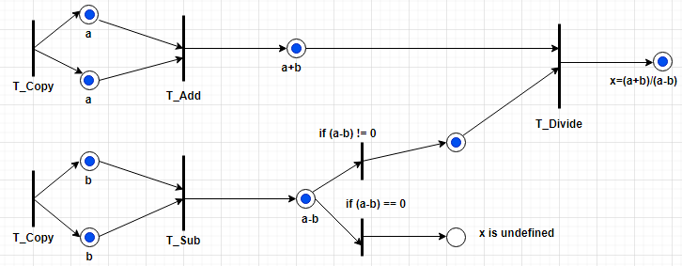
Petri Nets……………………………………..
Example 3
Fig :- Petri Net showing a data flow computation of $x=\frac{a+b}{a−b}$

Slide 59
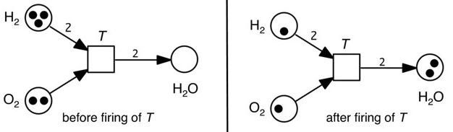
Petri Nets……………………………………..
Example 4
Fig :- Petri Net showing an equation $2H_{2}+O_{2}→2H_{2}O$

Slide 60
Petri Nets……………………………………..
Formal Definition
PN = (P, T, I, O, M_{t0}) where
P → set of places = {P₁, P₂, ……,P_{m}}
T → set of transitions = {T₁, T₂, …….T_{n}}
I → is an input matrix on n × m
O → is an output matrix of n × m
M_{t0} → represents initial marking of machine
Note:-
A marking of a PN at time t,
M(t) = {M₁(t), M₂(t),………………….M_{m}(t)}
where M_{i}(t) = no. of tokens in place i at time t)

Slide 61

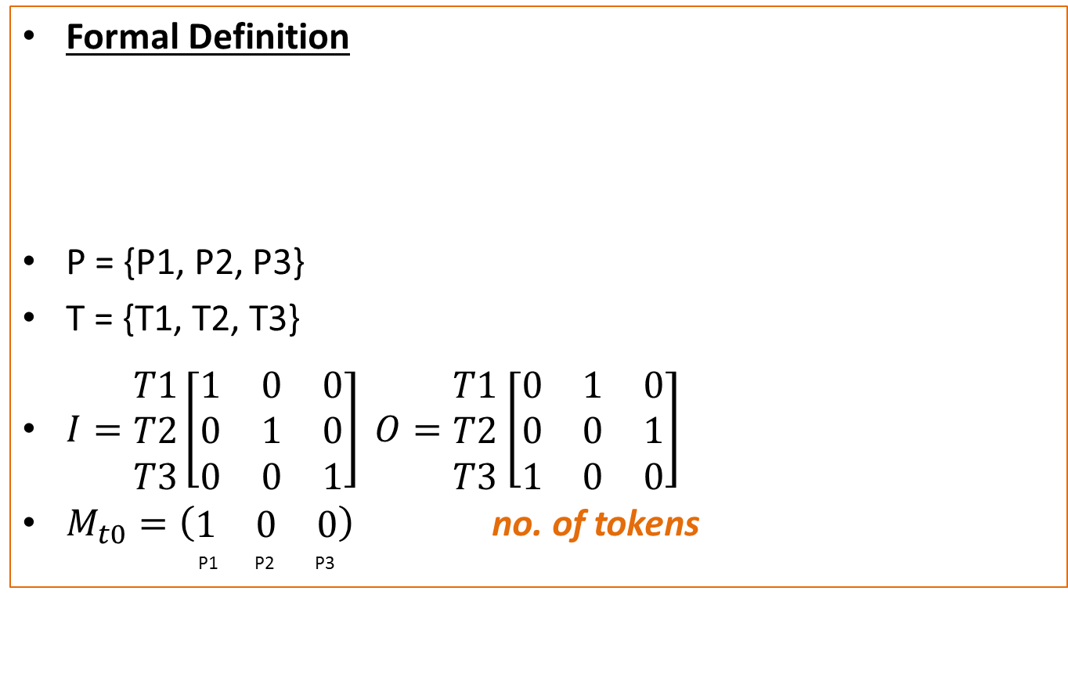
Petri Nets……………………………………..
Formal Definition
P = {P1, P2, P3}
T = {T1, T2, T3}
$I=\begin{matrix}T1 \\ T2 \\ T3\end{matrix}\left[\begin{matrix}1 & 0 & 0 \\ 0 & 1 & 0 \\ 0 & 0 & 1\end{matrix}\right]$ $O=\begin{matrix}T1 \\ T2 \\ T3\end{matrix}$ $\left[\begin{matrix}0 & 1 & 0 \\ 0 & 0 & 1 \\ 1 & 0 & 0\end{matrix}\right]$
$M_{t0}=\left(\begin{matrix}1 & 0 & 0\end{matrix}\right)$ no. of tokens
P1 P2 P3
P1
P2

Slide 62


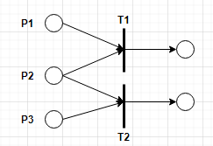
Variations in PN
Sequential Action
Dependency
Conflict

Slide 63
Variations in PN…………………………..
In Case of Conflict
P1 and P2 have tokens but not P3 then T1 is fired
P2 and P3 have tokens but not P1 then T2 is fired
If all have tokens which one to fire then conflict (Solution may be priority)

Slide 64
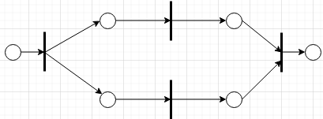
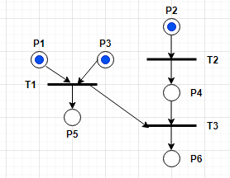
Variations in PN……………………..
4. Concurrency
5. Confusion
(Conflict+ Concurrency)

Slide 65
Variations in PN……………………..
In case of confusion
Two possible interpretation
T1 occurred first without being in conflict with other events then T2 occurred
T2 occurred first and then T1, T3 got in conflict
Conflict (T1, C1) = φ where C1 = {P1, P2, P3}
Conflict (T1, C2) = {T3} where C2 = {P1, P3, P4}

Slide 66

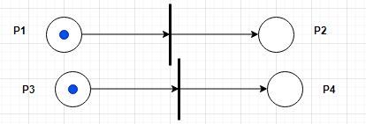
Pure and Simple Net
Let PN = (P, T, F) p t I o m
PN is pure if ∀x ∈ X : •x ∩ x• = φ
(No Self LOOP)
PN is simple if ∀x, y ∈ X : [(•x = •y and x • = y •) ⇒ x = y]

Slide 67
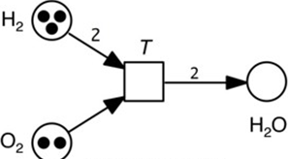
Place / Transition Net (P/T Net)
Defined by 4 tuples (P, T, F, W) where (P, T, F) is a Petri Net and W is a weight function
Example
4

Slide 68
Place / Transition Net (P/T Net)……
Transition Rule
Let M = (P, T, F, W, M₀) be a place transition system
A transition t ∈ T is enabled at M
M [ t > if ∀p ∈ P, W(p, t) ≤ M(s)
Eg:-
M₀ [t₁ > M₁ m0= 2, 1, 0 t1=t m1=1, 0, 1
2. A transition t enabled at M may fire yielding a new marking M’, M [ t > M’, such that ∀p ∈ P
M’(p) = M(p) – W(p, t) + W(t, p)

Slide 69
Assignment
Design a Petri Net to simulate the behavior of the following finite state machine
A vender machine that accepts 5 and 10 cents.
Sell candy bars worth 15 or 20 cents
Maximum hold up coins = 20 cents

Slide 70
Properties of Petri Nets
Reachability
Boundness
Liveness
Reversibility

Slide 71
Properties of Petri Nets……………….
Reachability
A marking M is said reachable from another marking M’, if there exists a sequence, σ, of transitions such that
M’ [σ > M
i.e. M’ t₁ M’’ t₂ M’’’ t₃ ……….t_{n} M, where σ = t₁t₂….t_{n}
R(M₀) → set of markings, reachable from the initial marking M₀

Slide 72
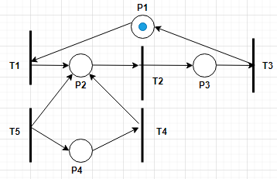

Properties of Petri Nets……………….
M1=(0,1,0,0)
Reachability (Example)
M0=1,0,0,0
M1=0,1,0,0
M2=0,0,1,0
$$M_{0}=\left({P1 \atop 1}, {P2 \atop 0},{P3 \atop 0},{P4 \atop 0}\right)$$
$$R\left(M_{0}\right)=\{\left(0,1,0,0\right),$$
(0,0,1,0),
(0,0,0,1)}
Quiz:-
(1,0,1,0) →not Reachable
0,1,0,0---T 20,0,1,0---T3 1,0,0,0

Slide 73
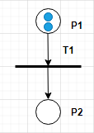
Properties of Petri Nets……………….
Reachability (Example)
M₀ =(2,0)
R(M₀) = (1,1) (0,2)
3
(2,0) [ T1 > (1,1)
Man
woman

Slide 74
Properties of Petri Nets……………….
Boundness
No. of tokens in a place be bounded
A place P is said to be k – bounded, if the number of tokens in P never exceed k, i.e. M(P) ≤ k
A petri net is said to be k – bounded if all places are k – bounded
A petri net is said to be bounded if it is k – bounded for some k > 0

Slide 75
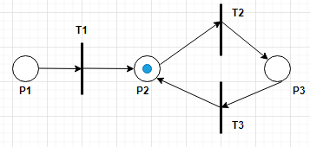
Properties of Petri Nets……………….
Liveness
A transition is said to be live if it can always be made from any reachable marking
i.e. ∀M ∈ R(M₀), ∃M’ ∈ R(M) such that M’ [t >
A transition is deadlocked if it can never fire
A transition is live if it can never deadlock
A petri net is live if all its transitions are live
A transition is said quasi live if it can be fired at only once
T1 → Dead
T2 → Live
T3 → ?????

Slide 76
Properties of Petri Nets……………….
Reversibility
A petri net is said reversible, if the initial marking remains reachable from any reachable marking
i.e. M₀ ∈ R(M), ∀M ∈ R(M₀)

Slide 77
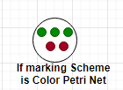
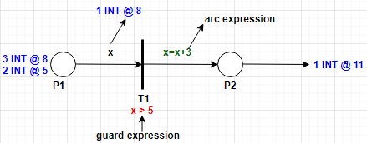
High Level Petri Net
Consists of the following features
Petri net
Marking Scheme (Like Color Petrinet)
Transition Guard
Arc Expression
Example

Slide 78
End of Session Unit 1.3

Slide 79
Unit 1.4 :- Complexity Theory

Slide 80
Complexity Theory
Estimates the amount of computational resources (time and storage) need to solve a problem
Basic Terms
Introducing a notation to specify complexity
Introduce a mathematical notation to specify the functional relationship between the input size of the problem and consumption and computational resources
Choice of machine model to standardize the measure
Specify the underlying machine model to prescribe the measures for the consumption of resources
So that machine cannot exceed the resources prescribed by the writer of the algorithm
Refinement of the measures of parallel computation
How fast can we solve the problem, when a large number of processors are put together to work in parallel

Slide 81
Turing Machine as a basis of consequences
Simplicity of abstraction
Dual nature of TM
Inclusion of non – determinism
Realization of unbounded parallelism
Provision of an easy abstract measure for resources

Slide 82
Simplicity of abstraction
Simple model of an abstract machine that consists of three components
Finite state machine
A read/write head
Infinite tape memory
Mathematically Turing machine can be defined by
TM = (Q, Σ, Γ, δ, q₀, B, F), where
Q → set of states
Σ → set of input alphabet
Γ → set of tape symbols
δ → transition function
q₀ → starting state
B → blank symbol
F → set of final states

Slide 83
Dual nature of TM
Universal TM
TM whose input consists of program and a data set for the program to process
Specialty (can simulate any special purpose algorithm) and universality (can simulate any other TM)

Slide 84
Inclusion of non – determinism
NDTM → alternative moves
Branching tree called OR tree
A computation halts, if there is a sequence that leads to an accepting state
Rejects an input if and only if there is no possible sequence of moves

Slide 85
Realization of unbounded parallelism
NDTM can be simulated using DTMs by allowing unbounded parallelism in computation
Each time a choice is made, the DTM makes several copies of itself
One copy is made for each possible choice
Thus many copies of DTM are executing at the same time at different nodes in the tree
The copy of DTM that reaches a solution early halts all other DTM, if a copy fails, it only terminates

Slide 86
Provision of an easy abstract measure for resources
DTM → by counting each moves as one unit time and each cell as scanned as one space time
NDTM → complexity is the number of moves required for an accepting sequence of moves since there are accepting sequence

Slide 87
ATM (Alternating Turing Machine)
Consists of an infinite memory tape and a finite state control as in TM
States of ATM are partitioned into normal, existential and universal states
Universal State → it leads to an acceptance, if and only if all of its descendants lead to an accepting state i.e. AND tree
Existential State → a computation is accepting if and only if at least one of its descendants is accepting i.e. OR tree
Normal State → computation leads to an acceptance if and only if its unique descendent is accepting

Slide 88
Satisfiabilty Problem
Let S = (x1 ∨ x2) ∧ (x3 ∨ x4 ∨ x5) ∧………
Is there an assignment to each literal such that the sentence is true
Example
Let E be an CNF (Conjunctive Normal Form)
E = (x ∨ y ∨ z) ∧ (x ∨ ¬y ∨ ¬w) ∧ (¬z ∨ w) ∧ (¬x)
Satisfiable under x = z = w = F and y = T
But E = (x ∨ y) ∧ (¬x) ∧ (¬y) ??????

Slide 89
Parallel Complexity Models
Synchronous parallel computation can be used to solve problems like matrix multiplication
In a synchronous parallel system, it is easy to measure the time in terms of clock cycle
It is because all identical processors work under the control of centralized clock

Slide 90
VLSI Computational Complexity
Practical use of algorithm depends upon the design of VLSI
Because the manner in which the signal propagates, influences the algorithm
Two fundamental parameters deciding the efficiency of VLSI chip is
Area of circuit (Space complexity)
Time taken to provide an output for a given input (Time complexity)

Slide 91
End of Session Unit 1.4

Slide 92
Unit 1.5 :- Distributed Computing

Slide 93
Distributed Computing
Major obstacles in distributed computing is uncertainty due to differing processor speed, and occasional failure of components
A system consists of n processors P₁,P₂,……,P_{n} and the network net
Each processor P_{i} is modeled as state machine with state sets Q_{i}
The state set Q_{i}, contains a distinguished initial state q_{0,i}
Each processor P_{i}, contains buff_{i}, in which incoming messages are buffered

Slide 94
Leader Election
In distributed computing, leader election is the process of designating a single processor as the leader of some task distributed among several computer
The existence of leader can simplify co-ordination among the processors and is helpful in achieving fault tolerance and saving resources
Election Algorithm
Bully Algorithm
Ring Algorithm

Slide 95
Bully Algorithm
The biggest guy in town always win
When a process notices that the coordinator is not responding to request, it initiates as election
Procedure
Each process has a unique processor ID
Processes know the IDs and address of every other processes
Communication is assumed reliable
Process initiates election if the coordinator failed
Select the processor with highest ID

Slide 96
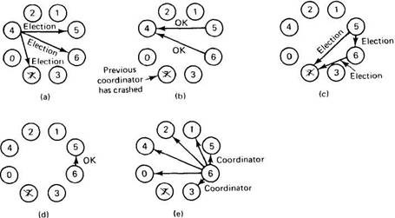
Bully Algorithm…………………………….
The job of 4 is done
Since 7 is crashed it
does not received
The message
Both 5 and 6 hold the
election
6 is announcing
6 is winner

Slide 97
Ring Algorithm
If any process notices that the current co-ordinator has failed, it starts an election by sending message to the first neighbor of the ring
The election message contains the node’s identifier and is forwarded around the ring
Each process adds its own identifier to the message
When the election message reaches the originator, the election is complete
Co-ordinator is chose based on the highest numbered process
This algorithm assumes that the link between the processes are unidirectional and every process can manage to the process on its right only
System is organized as a ring
Uses data structure as active list, a list that has priority number of all active processes in the system

Slide 98
Ring Algorithm……………………………
Procedure
If process P1 detects a coordinator failure, it creates a new active list which is empty initially. It sends election message to its neighbor on right side and adds number, to its active list
If process P2 receives message, in the same away it adds its number in active list and forwarded the message to its neighbor
If a process receives its own message, then it detects the process with highest number as a new leader

Slide 99

Ring Algorithm……………………………
Step 1:- 2 and 5 are initiating the election
Step 2 :- They forward the election message to its neighbor with its IDs and so on until the circuit builds
Step 3:-
2 → [2,3,4,5,6,0,1,2]
5 → [5, 6,0,1,2,3,4,5]
Both elect 6 as new leader

Slide 100
Ordering of events
Ordering between the events in the system
Eg:- an ordering between events by different processors that request permission to use some shared resource to grant the request in a far manner

Slide 101

Logical Clock
A man with one clock knows what time it is but a man with two is never sure
Assign logical time stamps to events based on ordering among them
If event a happened before event b, then it can be represented as
a → b OR $a<_{h}b$
If $a→b$ and $b→c$ then $a→c$
If $a<_{h}b$ then T(a) < T(b) where T is timestamp
But if T(a) < T(b) then can we guarantee $a<_{h}b$

Slide 102
Logical clock and concurrency
Assign a clock to each events, if a → b, then clock(a) < clock(b)
If a and b occur on different processes, that do not exchange message, then neither a → b nor b → a are true, these events are called concurrent

Slide 103

Lamport’s Logical Clock
Let us assume the following example
Lamport’s Algorithm
Each message carries a time stamp of the sender’s clock
When a message arrives
If receiver’s clock < (message_time _stamp)
set system clock to (message_time _stamp+1)
Else do nothing
Bad ordering
(e,h)5<2no
(f,k) 6<2 no
(j,c)(1,3)1<3

Slide 104
Vector Clock
Rules
Vector initialization to 0 at each process
V_{i}[j] = 0, for i, j = 1, 2, ………………………, N
Process increments its elements of the local vector before time stamping event
V_{i}[i] = V_{i}[i] + 1
Message is sent from process P_{i} with V_{i} attached to it
When P_{i} receives message, compare vector elements, and set local vector to higher of two values
V_{j}[i] = max (V_{i}[i] , V_{j}[i] )

Slide 105
Vector Clock………………………………..
Comparing vector timestamps
V = V’ iff V[i] = V’[i] for i = 1, 2, ………………..,N
V ≤ V’ iff V[i] ≤ V’[i] for i = 1, 2, ………………..,N
For any two events e and e’
If e → e’ then V(e) < V(e’)
If V(e) < V(e’) then e → e’
Two events e and e’ are concurrent iff neither V(e) < V(e’) is true nor V(e’) < V(e) is true

Slide 106

Vector Clock………………………………..
Example
(2, 1, 0)
(2, 2, 0)
(2, 2, 2)

Slide 107
Vector Clock………………………………..
Events Timestamp
a (1, 0, 0)
b (2, 0, 0)
c (2, 1, 0)
d (2, 2, 0)
e (0, 0, 1)
f (2, 2, 2)
Which are concurrent events?

Slide 108

Vector Clock………………………………..
Example
?
?
?
?
?
?

Slide 109

Vector Clock………………………………..

Slide 110
Resource Allocation
Problem arises in distributed systems when processors needs to share resources
In such problem, the program is partitioned into 4 regions int a….. P{……a=a+1…..}
Trying → where the processor tries to acquire the resources
Critical → where the resources are being used
Exit → where some cleanup is performed
Remainder → the rest of the code

Slide 111
Tolerating processor failure in synchronous system
In real systems, the various components may not operate correctly all the time
It is assumed that communication links are reliable but processors are not reliable
Two types of failure
Crash Failure
Byzantine Failure

Slide 112
Tolerating processor failure in synchronous system……………………
Crash Failure
When a processor halt during execution
A processor crashes in round r, if it correctly operates in round 1, 2, ………, r-1 and it does not take a step in round r + 1
Once the processor crashes, it is of no interest to the algorithm and no requirements are made on its decisions
Byzantine Failure
Where failed processor (traitor) can behave arbitrarily
Faulty processor is called Byzantine
It can send different message to different processors, that is not supposed to send by it

Slide 113
Assignment
Discuss on
Sparse Network Covers
Tolerating Processor failure in Asynchronous system
Wait free implementation of shared object
Due date :- 2020 june 15

Slide 114
End of Session Unit 1.5

Slide 115
Unit 2.1 :- PRAM Models

Slide 116
PRAM Models
Parallel Random Access Machine Models
Parallel can be defined as a technique for increasing the computation speed for a task by dividing the algorithm into several sub tasks and allocating multiple processors to execute sub tasks simultaneously

Slide 117
PRAM Models……………………………...
Example
Finding the smallest value in the set if N values
Algorithm 1
All possible comparisons of the pairs of the elements from set of numbers and carried out simultaneously each processor executing one operation of comparison

Slide 118

PRAM Models……………………………...
Algorithm 2
Do in parallel (Actual no. of processors required $\left(P\right)=\frac{n(n−1)}{2}$)
P_{i} derives the pair (i₁, i₂) of indices that corresponds to a different I
P_{i} reads value L(i₁) and L(i₂)
If L(i₁) ≥ L(i₂) then P_{i} sends negative outcome to Pi₁ else P_{i} sends negative outcome to Pi₂
As this stage the only active processors is P_{j}, 1≤j ≤n, which did not receive a negative outcome
P_{j} reads the value of L(j) and write it into the output cell

Slide 119

PRAM Models……………………………...
Tracing (Algorithm 2)
Example
L = {2, 6, 4, 8}, No. of elements (n) = 4
So, no. of processors $\left(P\right)=\frac{n(n−1)}{2}=\frac{4∗3}{2}=6$
P₁ → <1, 2> → -ve P₂
P₂ → <1, 3> → -ve P₃
P₃ → <2, 3> → -ve P₂
P₄ → <1, 4> → -ve P₄
P₅ → <2, 4> → -ve P₄
P₆ → <3, 4> → -ve P₄
Here, for 1 ≤ j ≤ n(4), among P₁, P₂, P₃
and P₄, P₁ didn’t get –ve outcome, so
j=1 and L(1) = 2 is the smallest element

Slide 120

PRAM Models……………………………...
Tracing (Algorithm 2)
Here processor P_{i} is chose as $i=\frac{(i_{2}−1)(i_{2}−2)}{2}+i_{1}$
Example → {2, 6, 4, 8}
(1, 2) → $\frac{(2−1)(2−2)}{2}+1=1→P_{1}$
(1, 3) → $\frac{(3−1)(3−2)}{2}+1=2→P_{2}$
(1, 4) → $\frac{(4−1)(4−2)}{2}+1=4→P_{4}$
(2, 3) → $\frac{(3−1)(3−2)}{2}+2=3→P_{3}$
(2, 4) → $\frac{(4−1)(4−2)}{2}+2=5→P_{5}$
(3, 4) → $\frac{(4−1)(4−2)}{2}+3=6→P_{6}$

Slide 121


Techniques for the design of parallel algorithm
Divide and conquer techniques
Balanced binary tree method
[3,7,8,3,9,2,3,1]→ [7,8,9,3]→[8,9]→9

Slide 122
PRAM Model
EREW (Exclusive Read Exclusive Write) → every memory cell can be read or written to by only one processor at a time
CREW (Concurrent Read Exclusive Write) → multiple processors can read a memory cell but only one can write at a time
ERCW (Excusive Read Concurrent Write) → never considered
CRCW (Concurrent Read Concurrent Write) → multiple processors can read and write (Issues:- on concurrent write it can be assumed that all the processors are writing the same value otherwise, priority can be assigned to solve

Slide 123

Optimality and efficiency of parallel algorithm
Let A be a problem of size N
Assumed that A can be solved on a PRAM by a parallel algorithm P_{A} in time T(N) by employing P(N) processors
Work of a parallel algorithm A is,
W(N) = T(N) * P(N)
$Speedup=\frac{t(N)}{T(N)}$ where t(N) → sequential time
$Efficiency=\frac{Sppedup}{P(N)}$

Slide 124
Basic PRAM algorithms
Computing Prefix sums
List Ranking
Parallel Sorting Algorithm

Slide 125
Computing Prefix sums
Given, A = {a₀, a₁, a₂, ……………. , a_{n-1}}
We have to compute,
{a₀, (a₀ + a₁), (a₀ + a₁ + a₂), …….., (a₀ + a₁ + ………..+a_{n-1})}
Eg
A = {5, 3, -6, 2, 7, 10, -2, 8}
The output is
{5, 8, 2, 4, 11, 21, 19, 27}

Slide 126

Computing Prefix sums………………..
Algorithm
Input an array [a₁, a₂, …………., a_{n}]
If (n == 1) then S₁ ← a[1]
Else
For j = 0 to logn – 1 do
For i = 2^{j} + 1 to n do in parallel
Processor P_{i}
Obtains a[i – 2^{j}] from $P_{i−2^{j}}$through shared memory
a[i] = a[i - 2^{j}] + a[i]

Slide 127

Computing Prefix sums………………..
Tracing :- A = {5, 3, -6, 2, 7, 10, -2, 8}
n = 8, logn → log₂2³ → 3
j = 0 j = 1 j = 2
i=2^{j}+1 to n : 2→8
i=2 →$P_{i−2^{j}}$ read a[i-2^{j}]
→ $P_{2−2^{0}}$ read a[2-2⁰]
→ $P_{1}$ read a[1] = 3
→ a[i] = a[i - 2^{j}] + a[i] → a[2] = a[1] + a[2] = 5+3=8
i=3
a[3] = a[2] + a[3] = 3 + (-6) = -3
i=4
i=5
i=6
i=7
i=8

Slide 128

List Ranking
The problem is that, given a singly linked list L, with N objects, for each node compute the distance to the end of the list
If d denotes the distance
Parallel algorithm
Assign one processor for each node
For each node i, do in parallel
i.d = i.d + i.next.d
i.next = i.next.next

Slide 129





List Ranking…………………………………
Illustration
P1
P2
P3
P4
P5
P6
1
1
1
1
1
0
/
2
2
2
2
1
/
0
/
4
4
3
/
2
/
5
/
4
/

Slide 130
Parallel Sorting Algorithm
Bitonic sort
Consists of two sequences, one increasing and one decreasing
Eg:- 5, 6, 7, 8, 4, 3, 2, 1
It is a sequence of elements <a₀, a₁, ……, a_{n-1}>, there exists <a₀, a₁, …., a_{i}> is increasing and <a_{i+1}, a_{i+2}, ……., a_{n-1}> is decreasing
If an/2 is the beginning of the decreasing sequence S, then
L(S) = {min(a₀, a_{n/2}), min(a₁, a_{n/2+1}),…..,min(a_{n/2-1}, a_{n-1}}
R(S) = {max(a₀, a_{n/2}), max(a₁, a_{n/2+1}),….., max(a_{n/2-1}, a_{n-1}}

Slide 131
Parallel Sorting Algorithm……………
Algorithm
Input → a bitonic sequence S
If S is the length of 1 then STOP
Else
Form L(S) and R(S)
Do in parallel
L(S) ← Recursive bitonic merge L(S)
R(S) ← Recursive bitonic merge R(S)
Concatenate L(S) and R(S)

Slide 132
Parallel Sorting Algorithm……………
Illustration
3, 5, 8, 9, 7, 4, 2, 1
R(S)
L(S)
3, 4, 2, 1
7, 5, 8, 9
L(S)
R(S)
R(S)
L(S)
2, 1
3, 4
7, 5
8, 9
L(S)
R(S)
L(S)
R(S)
R(S)
R(S)
L(S)
L(S)
1
2
3
4
5
7
8
9

Slide 133
Randomized Algorithm
Is the algorithm where execution is controlled at one or more points by randomly made choices
Primality Testing
Fermat’s Little Theorem
Where b ∈ Z_{p}

Slide 134
Deficiencies of PRAM algorithm
No mechanisms for representing communication between the processors
Storage management and communication issues are hidden from the algorithm designer

Slide 135
End of Session Unit 2.1

Slide 136
Unit 2.2 :- BSR (Broadcasting with Selective Reduction)

Slide 137
BSR
Broadcast instruction consists of three phases
Broadcast Phase
Selection Phase
Reduction Phase
Broadcast Phase
Allows all of the N processors to write concurrently to all of the M memory locations
Each processor P_{i}, 1≤i≤N, produced a record containing two fields, a tag t_{i} and a datum d_{i}, to be stored

Slide 138

BSR…………………………………………….
Selection Phase
After the data are received at each memory locations Uj, 1≤j≤M, a switch Sj will select the receiving data di by comparing tag value ti by using a selection rule, σ [<, ≤, =, >, ≥, ≠]
Reduction Phase
Selected data are reduces to a single value using reduction rule, R {Σ, π, ∧, ∨, ⊕,$\begin{matrix}max \\ ∩\end{matrix},\begin{matrix}min \\ ∪\end{matrix}$}

Slide 139

BSR…………………………………………….

Slide 140

BSR…………………………………………….
A generalized BSR model
Mathematically, it can be expressed as
$U_{j}←{Rd}_{i}|$∧ t(i, h) σ_{h} l(j, h)
1≤j≤M 1≤i≤N 1≤h≤k 1≤j≤M
Where
N → no. of processors
d_{i} → datum broadcast by the processor P_{i}
σ_{h} → selection operation, 1≤h≤k, where k is the number of criteria
t(i, h) → tag broadcast by processor i for criteria h
l(i, h) → limit value j for criteria σ_{h}
R → reduction operation, R ∈ {Σ, π, ∧, ∨, ⊕, ∩, ∪}
U_{i} → memory location to be stored for the single reduced value

Slide 141
BSR…………………………………………….
Types
One criterion BSR algorithm
Two criterion BSR algorithm
Three criterion BSR algorithm
Multiple criterion BSR algorithm

Slide 142
One Criterion BSR
Each broadcast datum has to pass a single test being allowed to participate in the reduction process
Example
Sorting
Parenthesis Matching
Optimal Sum Subsegment

Slide 143
One Criterion BSR……………………….
Sorting
Number of processors needed = N (number of elements in array is N)
Rank of element xj can be expressed as
r_{j} = Σ1 | x_{i} ≤ x_{j}
When all the elements in the array are distinct, every datum x_{j} in its position r_{j} are in the sorted array

Slide 144
One Criterion BSR……………………….
Sorting
Illustration
A = {3, 2, 6, 5}
P1 P2 P3 P4
for 3 → 3 ≤ 3, 2 ≤ 3, ∴rank = 2
for 2 → 2 ≤ 2, ∴ rank =1
for 6 → 3 ≤ 6, 2 ≤ 6, 6 ≤ 6, 5 ≤ 6, ∴rank = 4
for 5 → 3 ≤ 5, 2 ≤ 5, 5 ≤ 5, ∴rank = 3
Hence the sorted array is {2, 3, 5, 6}

Slide 145
One Criterion BSR……………………….
Sorting
What happens if some of the elements are duplicate
A = {3, 4, 3}

Slide 146

One Criterion BSR……………………….
Sorting (in case of duplicate)
S_{j} = Σ1 | t_{i} ≤ l_{j} where $t_{i}=r_{i}−\frac{1}{i},l_{j}=r_{j}−\frac{1}{j}$
Illustration → A = {3, 4, 3}

Slide 147
Parenthesis Matching
One criterion BSR algorithm
The problem is to find the pairs of matching parenthesis in a given legal sequences l₁, l₂, ……., l_{n} of parenthesis
By legal means that every parenthesis has its matching parenthesis in a sequence
Example
Output for the input sequence,
( ) ( ( ( ) ) ) ( ( ) ) is,
Can be
Can be solved by N processors
( | ) | ( | ( | ( | ) | ) | ) | ( | ( | ) | )
1 | 2 | 3 | 4 | 5 | 6 | 7 | 8 | 9 | 10 | 11 | 12
2 | 1 | 8 | 7 | 6 | 5 | 4 | 3 | 12 | 11 | 10 | 9

Slide 148

Parenthesis Matching………………….
Algorithm
For each processor j do in parallel
If l_{j} == ‘(‘ then b_{j} = 1 else b_{j} = -1
P_{j} = Σb_{j} | i ≤ j
If b_{j} == -1 then P_{j} = P_{j} + 1
${P′}_{j}=P_{j}−\frac{1}{j}$
q_{j} = -1, t_{j} = 0, r_{j} = 0
$q_{j}=∩{P^{′}}_{i}|{P^{′}}_{i}<{P^{′}}_{j}$
$t_{j}=∩i | {P^{′}}_{i}=q_{j}$
$r_{j}=∪i|t_{i}=j$
If l_{j} = ‘)’ then m_{j} = t_{j} else m_{j} = r_{j}

Slide 149
Parenthesis Matching
One criterion BSR algorithm
The problem is to find the pairs of matching parenthesis in a given legal sequences l₁, l₂, ……., l_{n} of parenthesis
By legal means that every parenthesis has its matching parenthesis in a sequence
Example
Output for the input sequence,
( ) ( ( ( ) ) ) ( ( ) ) is,
Can be
Can be solved by N processors
( | ) | ( | ( | ( | ) | ) | ) | ( | ( | ) | )
1 | 2 | 3 | 4 | 5 | 6 | 7 | 8 | 9 | 10 | 11 | 12
2 | 1 | 8 | 7 | 6 | 5 | 4 | 3 | 12 | 11 | 10 | 9

Slide 150
Parenthesis Matching………………….
Algorithm
For each processor j do in parallel
If l_{j} == ‘(‘ then b_{j} = 1 else b_{j} = -1
P_{j} = Σb_{j} | i ≤ j
If b_{j} == -1 then P_{j} = P_{j} + 1
${P′}_{j}=P_{j}−\frac{1}{j}$
q_{j} = -1, t_{j} = 0, r_{j} = 0
$q_{j}=∩{P^{′}}_{i}|{P^{′}}_{i}<{P^{′}}_{j}$
$t_{j}=∩i | {P^{′}}_{i}=q_{j}$
$r_{j}=∪i|t_{i}=j$
If l_{j} = ‘)’ then m_{j} = t_{j} else m_{j} = r_{j}

Slide 151




Parenthesis Matching
j=1, P’₁=0,there is no less P’ value less than 0
j=2, P’₂=0.5,less than 0.5=0,and max = 0
j=4, P’₄=1.75, less than 1.75 =
0,0.5,0.66,0.87,0.89,0.92 and
max = 0.92
 | P1 | P2 | P3 | P4 | P5 | P6 | P7 | P8 | P9 | P10 | P11 | P12
Sequence | ( | ) | ( | ( | ( | ) | ) | ) | ( | ( | ) | )
Index(j) | 1 | 2 | 3 | 4 | 5 | 6 | 7 | 8 | 9 | 10 | 11 | 12
b_{j} | 1 | -1 | 1 | 1 | 1 | -1 | -1 | -1 | 1 | 1 | -1 | -1
∑b_{i} | i≤ j | 1 | 0 | 1 | 2 | 3 | 2 | 1 | 0 | 1 | 2 | 1 | 0
P_{j} | 1 | 1 | 1 | 2 | 3 | 3 | 2 | 1 | 1 | 2 | 2 | 1
P’_{j} | 0 | 0.5 | 0.66 | 1.75 | 2.8 | 2.83 | 1.86 | 0.87 | 0.89 | 1.9 | 1.91 | 0.92
q_{j} | -1 | -1 | -1 | -1 | -1 | -1 | -1 | -1 | -1 | -1 | -1 | -1
q_{j} | -1 | 0 | 0.5 | 0.92 | 1.91 | 2.8 | 1.75 | 0.66 | 0.87 | 1.86 | 1.9 | 0.89
t_{j} | 0 | 1 | 2 | 12 | 11 | 5 | 4 | 3 | 8 | 7 | 10 | 9
r_{j} | 2 | 3 | 8 | 7 | 6 | 0 | 10 | 9 | 12 | 11 | 5 | 4
m_{j} | 2 | 1 | 8 | 7 | 6 | 5 | 4 | 3 | 12 | 11 | 10 | 9
J=1
J=1, (
J=7, )

Slide 152
Maximal Sum Sub Segment
Given an array of numbers d₁, d₂, ……., d_{m}, it is required to find a contiguous sub array of maximal sum
Example
A = {-2, -3, 4, -1, -2, 1, 5, -3}
Maximal Sum = 4 + (-1) + (-2) + 1 + 5 = 7

Slide 153

Maximal Sum Sub Segment…………
Algorithm
$S_{j}=\sum{d_{i}|i≤j}$
$m_{j}=∩S_{i}|i≥j$
$e_{j}=∩i|S_{i}=m_{j}$
$m_{j}=m_{j}−S_{j}+d_{j}$
$t=∩m_{i}$
$x=∩i|m_{i}=t→starting point$
$y=e_{x}→ending point$

Slide 154
Maximal Sum Sub Segment…………
Tracing
A = {31, -41, 59, 26, -53, 58, 97, -93, -23, 84}

Slide 155

Two criterion BSR algorithm
BSR algorithm where broadcast data are tested for their satisfaction of two criteria before being allowed to take part in reduction process
Example
Counting inversions in a permutation
Given a set S, a permutation π of S is a set S’, containing all elements of S, but in different order
Inversions in permutations are those numbers of pairs, which are in disorder
Eg
No. of inversions in {1, 6, 2, 9, 5, 3} = 3
They are {6, 2}, {6, 5}, {9, 5}
Rules
$y_{j}=\sum{1}|\left\{i<j\right\} \bigwedge{\{π\left(i\right) > π(j)\}}$

Slide 156


Three criterion BSR algorithm
Have to pass three criterion to go to reduction process
Eg:- vertical segment visibility
${lt}_{j}=∩i|x_{i}<x_{j}\bigwedge{t_{i}≥t_{j}\bigwedge{b_{i}≤t_{j}(left top)}}$
${rt}_{j}=∩i|x_{i}>x_{j}\bigwedge{t_{i}≥t_{j}\bigwedge{b_{i}≤t_{j}(right top)}}$

Slide 157
End of Session Unit 2.2

Slide 158
Unit 2.3 :- Data Flow Models

Slide 159
Data Flow Models
Flow of information between data processing entities
Control flow and data flow
Control flow assumes that a program in a series of instructions, each of which specifies
Either an operation with memory location
OR specifies transfer of control to another instruction
Example
C = if (n == 0) then a + b else a - b
But in data flow computing model, it executes any operation as soon as necessary operations are available

Slide 160



Basic primitives of data flow
a data value is produced by an operator
as a result of some operation f
a TRUE or FALSE control value is generated by a decider
(predicate) depending on its input tokens
a switch actor directs an input data token to one of its
output depending upon the control input

Slide 161


Basic primitives of data flow………..
A merge actor passes one of its input tokens
to the output depending on the input control
token
A copy is an identity operator which duplicates
input tokens

Slide 162


Basic primitives of data flow………..
Example
$$sum=\sum_{i=1}^{n}{f(i)}$$

Slide 163
Basic primitives of data flow………..
Description
Control units to the merge actors are set to FALSE for initialization
The input values i and sum are admitted as the initial values of the iteration
The predicate i≤n is then tested
If it is true, the values of i and sum are routed to the TRUE sides of switch
This initiates the firing at the function f as well as increment of i
Once the execution of the body of the loop completes, the next iteration initiated at the merge actors
The initiation continues until the condition i≤n is no longer true
The final sum is then routed out of the loop and the initial Boolean values at merge actors are restore to FALSE

Slide 164

Basic primitives of data flow………..
Example
Fig:- Dataflow graph for C = IF n == 0
THEN a + b ELSE a - b

Slide 165
Demand Driven Data Flow Computing Model
An operation of a node will be performed only if there are tokens on all the input edges and there is a demand for the result of applying the operation
Operator net
Programming model for demand driven
Consists of set of nodes, a set of arcs and set of equation that relate the output arcs of nodes to functions / operators applied to the input arcs

Slide 166


Demand Driven Data Flow Computing Model………………………………………………
Example (Operator net)
fby → followed by
asa → as soon as
$$S=\sum_{i=1}^{n}{f(x)}$$

Slide 167
Assignment
Data flow architecture
Static Data flow model
Dynamic Data flow model

Slide 168
End of Session Unit 2.3

Slide 169
Unit 2.4 :- Partitioning and Scheduling

Slide 170

Partitioning and Scheduling
Partitioning deals with
parallelism

Slide 171
Partitioning and Scheduling…………
Program Partitioning
Data Partitioning
Same computation on different set of data concurrently
Eg:- matrix multiplication
Function Partitioning
Different computation on same set of data concurrently
Eg:- flight simulation

Slide 172
Task Scheduling
After program partitioning, tasks must be optimally scheduled on the processors such that the program execution time is minimized
Scheduling techniques can be classified as deterministic and non-deterministic
In deterministic scheduling, all the information about tasks to be scheduled is entirely known prior to execution time
In non-deterministic, some information may not be known before program execution (Eg:- conditional branches)

Slide 173
Scheduling System Models
Consists of
Parallel program tasks
Target machine
Schedule
Performance criteria

Slide 174
Parallel program tasks
Can be defined as the system (T, <, D_{ij}, A_{i}), where
T = {t₁, t₂, ……….,t_{n}} is a set of tasks to be executed
< is a partial order defined on T, i.e. t_{i} < t_{j} means t_{i} must be completed before t_{j} can start execution
D_{ij} is an n×n matrix of communication data, where D_{ij} ≥ 0 is the amount of data required to be transmitted from task t_{i} to t_{j}
A_{i} is n vector of the amount of computations i.e. A_{i}>0, is the number of instructions required to execute t_{i}

Slide 175

Parallel program tasks………………….
Node number (Processor ID)
A_{i}
D_{ij}
Figure :- Task Graph (n = 7)

Slide 176

Target Machine
Assumed to be made up of “m” heterogeneous processing elements connected using an arbitrary interconnection network
Formally target machine can be defined as (P, P_{ij}, S_{i}, T_{i}, B_{i}, R_{ij}), where
P = {P₁, P₂,………….., P_{m}} is a set of m processors forming the parallel architecture
P_{ij} is an m×m interconnection topology matrix
S_{i} specifies the speed of processor P_{i}
I_{i} specifies the startup cost of initiating message m on processor P_{i}
B_{i} specifies the startup cost of initiating a process on processor P_{i}
R_{ij} is the transmission rate over link connecting P_{i} and P_{j}
Now execution time of task i on processor j (T_{ij}) can be computed as,

Slide 177

Schedule
Formally defined as
f : v → {1, 2, ………, m} × {0, 1, …….., ∞}
i.e. f(v) = (i, t) for some v means task v is scheduled to be processed by processor P_{i} starting at time t
Task 1 starts on processor P₂ at
time 0 and finishes at time 10
Task 5 starts on processor P₃ at
time 0 and finishes at time 30
Shaded area is communication
delay
f(5)=(P₃,0)
f(6)=(P₂,31)

Slide 178
Performance Criteria
Scheduling length or max finishing time
Formally
length(f) = maximum {t + T_{ij}}
Where f(i) = (j, t) ∀i ∈ v

Slide 179
Communication Model
Two key component that contribute to the total completion cost is
Execution Time
Communication Delay
Model A
Total cost = communication cost + execution cost
Where
Execution cost = schedule length
Communication cost = no. of message × cost per message
No. of message = the no. of node pairs (u, v) such that (u, v) ∈ A and proc(u) ≠ proc(v)
Model B
If tasks u, v and w ∈ V such that (u, v) , (u, w) ∈ A, then the result of computing u must be communicated to the processor v and w
This communication is counted twice in model A but one in model B

Slide 180

Communication Model………………..
Example
Suppose that each of given task takes one unit of execution time in either P₁ or P₂
Task a sends message to b, c, d, e
Suppose a, b, d → allocated to P₁
c, e → allocated to P₂
Model A
No. of message = |(a, c), (a, e)| = 2
Model B
No. of message = |(a, P₂)| = 1

Slide 181
Optimal Scheduling Algorithm
Deal in 3 cases
When the task graph is a tree
When the task graph is an interval order
When there are only 2 processors available

Slide 182
Scheduling tree structure task graphs
Scheduling in – forests / out – forests without communication
Scheduling in – forests / out – forests with communication

Slide 183


Scheduling in – forests / out – forests without communication
Task graph is either
In-forest → each node has at most one immediate successors OR
Out-forest →each node has at most one immediate predecessors
General strategy → used the highest level first
Algorithm
The level of each node in the task graph is calculated and used as each node priority
Whenever a processor becomes available, assign the unexecuted ready task with the highest priority

Slide 184

Scheduling in – forests / out – forests without communication……………………
Node | Priority
14 | 5
13 | 5
12 | 4
11 | 4
10 | 4
9 | 4
8 | 4
7 | 3
6 | 3
5 | 3
4 | 2
3 | 2
2 | 2
1 | 1
Example
 | P1 | P2 | P3
0 | 14 | 13 | 11
1 | 12 | 10 | 9
2 | 8 | 6 | 7
3 | 5 | 3 | 4
4 | 2
5 | 1
Level 5
Level 4
Task Scheduling
Task Priority
Level 3
Level 2
Level 1

Slide 185

Scheduling in – forests / out – forests without communication……………………
Example

Slide 186
Communication Model
Two key component that contribute to the total completion cost is
Execution Time
Communication Delay
Model A
Total cost = communication cost + execution cost
Where
Execution cost = schedule length
Communication cost = no. of message × cost per message
No. of message = the no. of node pairs (u, v) such that (u, v) ∈ A and proc(u) ≠ proc(v)
Model B
If tasks u, v and w ∈ V such that (u, v) , (u, w) ∈ A, then the result of computing u must be communicated to the processor v and w
This communication is counted twice in model A but one in model B
Model C
This model assumes the existence of an I/O processor that is associated with every processor in the system
A task can be assigned to a processor for execution while this processor is performing communication

Slide 187

Communication Model………………..
Example
Model A
No. of message = |(a, c), (a, e)| = 2
Total cost = 2*1 + 3 = 5
Model B
No. of message = |(a, P2)| = 1
Total cost = 1 * 1 + 3 = 4
Model C
Assume the communication delay between different processor is one unit of time
Total cost = schedule length = 4
Fig a :- Task Graph
Fig b :- Task Schedule (Model A and B)
Fig c :- Task Schedule (Model C)
Total cost = communication cost + execution cost
Communication cost = no. of message × cost per message

Slide 188

Communication Model………………..
Exercise
Calculate total cost using Model A, Model B and Model C
a. Task Graph b. Task Schedule (A & B) c. Task Schedule ©

Slide 189

Communication Model………………..
Total cost = 8*1 + 4 = 12

Slide 190
Scheduling in-forest / out-forest with communication
Based on the idea of adding new precedence relations to the task graph, then this task graph is called augmented task graph
Scheduling the augmented task graph without considering communication is equivalent to scheduling the original task graph with communication (H. El-Rewini, T. Lewis, and H. Ali, Task Scheduling in Parallel and DistributedSystems, Prentice Hall, Englewood Cliffs, N.J., 1994.)
Node – depth
The depth of a node is defined as the length of the longest path from any node with depth zero to that node
depth(u) → 1 + max { depth(v) } ∀v ∈ predecessor(u)
depth(u) → 0 if predecessor(u) = φ
Operation swap –all
Given a schedule f, the operation swap_all (f, x, y), where x and y are two tasks in f scheduled to start at time t, on processors i and j
The effect of this operation is to swap all the task pairs scheduled on processors i and j is the scheduled at time t₁, ∀t₁, t1 ≥ t

Slide 191
Scheduling in-forest / out-forest with communication………………………..
Algorithm
Given an in-forest G = (V, E), identify the set of siblings S₁, S₂,…………, S_{k} where S_{i} is the set of all nodes in V with a common child (S_{i})
A₁ ← A
For every set S_{i}
Pick node u ∈ Si with the maximum depth
A₁ ← A₁ – (v, child(S_{i})) ∀v ∈ S_{i} and v ≠ u
A₁ ← A₁ ∪ (v, u) ∀v ∈ S_{i} and v ≠ u
Obtain the schedule f by applying previous algorithm on the augmented in-forest f = (V, A₁)
For every set Si in the original in-forest G, if node u (with the maximum depth) is scheduled in f in the time slot immediately before child(s_{i}), but in a different processor, the apply the operation swap_all

Slide 192

Scheduling in-forest / out-forest with communication………………………..
Depth of a and b in S₁ and e and f in S₃ are same
Example
S₁
S₂
S₃
S₄
Depth of c is greater than d in S₂
Depth of g > h in S₄
Fig a :- original task graph
Fig b :- formation of S_{i}

Slide 193




Scheduling in-forest / out-forest with communication………………………..
Example…….
S₁ = {a, b} → b
S₂ = {c, d} → c
S₃ = {e, f} → f
S₄ = {g, h} → g
Case
S₁ = {a, b} → b
Fig c :- Augmented task graph
u = {b}, v = {a}

Slide 194
Scheduling in-forest / out-forest with communication………………………..
Example…….
Node | Level
a | 5
b | 4
c | 3
d | 4
e | 5
f | 4
g | 2
h | 3
i | 1
 | P1 | P2
0 | a | e
1 | b | d
2 | f | c
3 | h
4 | g
5 | i
 | P1 | P2
0 | a | e
1 | b | d
2 | c | f
3 |  | h
4 |  | g
5 |  | i
Fig e :- Task Scheduling
Fig f :- Task Scheduling after swap_all
Fig d :- Task Priority

Slide 195

Scheduling in-forest / out-forest with communication………………………..
Exercise

Slide 196
Scheduling Interval Ordered Task
Used to indicate that the task graph which describes the precedence relation among the tasks in an interval order
Without Communication
With Communication
Without communication
The number of all successors of each node is used as each node’s priority
Whenever a processor becomes available, assign it, with the unexecuted ready task with the highest priority

Slide 197

Scheduling Interval Ordered Task …
Without communication
Node | No. of successors
1 | 4
2 | 5
3 | 6
4 | 3
5 | 2
6 | 1
7 | 0
8 | 0
9 | 0
P1 | P2 | P3
3 | 2 | 1
4 | 5 | 6
7 | 8 | 9
Task Scheduling
Task Priority
Task Graph

Slide 198

Scheduling Interval Ordered Task …
Without communication (Ex)

Slide 199

Scheduling Interval Ordered Task …

Slide 200
Scheduling Interval Ordered Task …
With Communication
start_time (v, i, f) → earliest time at which task v can start execution on processor P_{i}, in schedule f
task(i, t, f)→task schedule on processor Pi at time t in schedule f
Algorithm
The number of all successors of each node is used as each node’s priority
Nodes with highest priority are scheduled first
Each task v is assigned to processor P_{i} with the earliest time start
If start_time(v, i, f) = start_time(v, j, f), 1 ≤ i, j ≤ m, task v is assigned to processor P_{i} if task(i, start_time(,v, i, f) – 1, f) has the smaller priority
Communication delay is considered as one unit of time

Slide 201
Scheduling Interval Ordered Task …
Example
Node | No. of successors
1 | 4
2 | 5
3 | 6
4 | 3
5 | 2
6 | 1
7 | 0
8 | 0
9 | 0
P1 | P2 | P3
3 | 2 | 1
6
4 | 5
7
 | 8 | 9
Task Scheduling
Task Priority
Task Graph

Slide 202

Scheduling Interval Ordered Task …
Exercise

Slide 203

Two Processor Scheduling
In this case, the no. of processors is limited to only two
Node | Label
a | 11
b | 10
c | 9
d | 8
e | 6
f | 7
g | 5
h | 4
i | 3
j | 1
k | 2
<9>
<8>
 | P1 | P2
0 | a | b
1 | c | d
2 | f | e
3 | g | h
4 | i | j
5 | k
11
10
<6,7>
<5,7>
9
8
<1,4>
<3,4>
7
<3>
6
5
<1,2>
<2>
4
3
Task Scheduling
1
Task Priority
<2>
2
<1>
Task Graph

Slide 204

Two Processor Scheduling
Ex

Slide 205
Scheduling Heuristic Algorithm
Priority based scheduling
Each node is assigned priority
As long as priority queue is not empty
A task is obtained from front of queue
An idle processor is selected
When all the immediate predecessors of a particular task are executed, the successor is now ready and inserted to the queue
Scheduling using clustering heuristics
Cluster merging → if no. if clusters is greater than no. of processors available
Physical mapping → to reduce the communication
Task execution ordering → after the processor is assigned, then execution ordering is determined

Slide 206

Scheduling Heuristic Algorithm…..
Task allocation using duplication
Communication Time
P1 | P2
a
b
 | c
P1 | P2
a | a
b | c
Task Graph
No Duplication
Task Duplication

Slide 207
End of Session Unit 2.4

Slide 208
Unit 2.5 :- Checkpoint in Parallel and Distributed System

Slide 209
Checkpointing in Parallel and Distributed System
Fault Detection
Process of recognizing that an error has occurred in the system
Fault Location
After the error in the system is detected, the location of the part in the system that cause the error is identified
Fault Containment
After the fault is located, the faulty part is isolated to prevent the possible propagation
Fault Recovery
Process of restoring the operational states of the system

Slide 210
Checkpointing using task duplication
Task duplication is analogous to shadowing techniques for recovery in database transaction system
Compares the state of same task that are executed in parallel on different processors
Here fault detection is achieved by duplicating the task into two or more processors and comparing the states of the processors at the checkpointing
Matching states is an indication of a correct execution

Slide 211

Checkpointing with simple rollback

Slide 212

Techniques for consistent Checkpointing
When a fault is detected in one of the processors, the process is rolled back to its last saved check point
In order to maintain consistent checkpoint, some other processes that communicates with this task need to be rolled back, called domino-effect
Domino-effect
Fault
Rollback

Slide 213
End of Session Unit 2.5

Slide 214
Unit 2.6 :- Open Distributed System

Slide 215
Open Distributed System
Distributed systems are complex structure composed of many types of hardware and software components
Eg Telecommunication system
Heterogeneous environment
Components of open distributed system architecture
End user viewpoint → information content by view of user
Enterprise viewpoint → describing the needs of the users of an information system
Computational viewpoint → distributed system seen by application designer or programmer
Information viewpoint → focuses on the information content of the enterprise (information semantics of distributed system)
Engineering viewpoint → system support for distributed application
Technology viewpoint → technical component

Slide 216

Open Distributed System…………
Engineering Model
A nucleus is an object that
provides access to basic processing,
storage and communication functions
of a node for use by BEO, TO and PO

Slide 217

Open Distributed System…………
Basic Engineering Objects are the run time representations of computational object
Single computer system
Special purpose model
Collection of BEO, TO, PO in a node
Responsible to make a bridge to communicate objects
Runtime binding between objects
Concepts of related modules

Slide 218
End of Session Unit 2.6

Slide 219
Unit 3.1 :- Fundamentals of Parallel Algorithm

Slide 220
Fundamentals of Parallel Algorithm
Models of parallel computation
PRAM Model
Complexity measure used for evaluating the performance of a PRAM algorithm is
Where T(n) → best sequential time
p → no. of processors
Shared Memory Model
Retains single address space of PRAM but assumes that the processors execute their operations asynchronously (like multiprogramming)
Network Model
Topology of the inter-connection network as the basis for modeling the communication between different processors
LogP Model

Slide 221

Fundamentals of Parallel Algorithm…
LogP Model
L→ upper bound of the latency occurred in communicating the message
o → overhead, length of a time that a processor is engaged in submission of a message
g → gap, minimum time interval between consecutive node message transmission and submission
P → no. of processors

Slide 222

Balanced Trees
A common strategy for designing parallel algorithms is to build a balanced tree on the input elements and traverse the tree, storing some information on internal node
Eg: Computing the sum of elements in the array
Algorithm( Data Parallel Sum)
Begin
For h=1 to k do
For do in parallel
A[i] = A[2i] + A [2i + 1]
S = A[0]
End

Slide 223
Divide and Conquer
Partitioning the input into several partitions of almost equal size
Solve each in parallel
Merge the solution
Eg: Quick Sort

Slide 224
End of Session Unit 3.1

Slide 225
Unit 3.2 :- Graph Theoretic Concepts and Notations

Slide 226


Graph Theoretic Concepts and Notations
Undirected graph
Sub-graph
Connected graph
If there is a path between every pairs of vertices
Bi-connected graph
Removing an arbitrary vertex along with all edges incident to it is still connected
Cut-vertex
A vertex v of G is cut vertex if the graph induced by v is not connected
Cut-edge
An edge {x,y} of G is bridge if the graph obtained from G by removing {x,y} is not connected
Clique
A clique is a graph of pair wise adjacent vertices
Matching
Is a set of edges sharing no common vertex

Slide 227
Tree Graph
Computing a post order numbering
Left, Right, Root
Given a rooted tree T along its Euler Tour, the task of computing a post order numbering of the nodes T can be performed as follows
For every node v of T, assign a weight of 0 to v¹, v²,……..,v^{d(v)} and weight of 1 to v^{d(v)+1}
Compute the weighted rank of every node in the Euler Tour
For every node v^{d(v)+1}, the corresponding weighted rank is the post order of v

Slide 228


Computing a post order numbering…..
Example
0
0
0
3
5
1
9
0
Euler Tour
0+0=0
0
3
0
0
0
1+0=1
2+1=3
0
5
6
1
1
5
1
8
1
1
7
0+1=1
1+1=2
1
1
1
4
6
Post Order (Left,Right,Root)
efbgchida
a=9
b=3
c=5
d=8
e=1
f=2
g=4
h=6
i=7
Post Order
efbgchida

Slide 229

Computing a post order numbering…..
Exercise (Compute post order of following tree)

Slide 230
Computing the number of descendants
Given the rooted tree T and Euler tour, assign a weight of 1 to u¹ and weight of 0, to u²,u³,……….,u^{d(u)+1}
Let r(u¹) and r(u^{d(u)+1}) be the corresponding values of prefix sum at u¹ and u^{d(u)+1} respectively
The number of descendants of u is exactly, r(u^{d(u)+1}) – r(u¹) + 1

Slide 231

Computing the number of descendants…
Example
9-1+1=9
1
4
6
9
3
9-7+1=3
Euler Tour
2
4
5
2
7
8
3
3
6
9
4
9
6
8

Slide 232
Computing the number of descendants…
Exercise (Compute the number of descendants of every node in following tree)

Slide 233
Level Computation
The level of a node v of T is defined as the number of edges on the path joining v to the root
Consider a tree T with Euler tour
Assign a weight of 1 to v¹ and weight of -1 to every v^{j} where j ≠ i
Example
Level 1
Level 2
Level 3

Slide 234

Level Computation……………..
Example
1
2
2
3

Slide 235
Level computation……
Exercise (Compute the level f every node in following tree)

Slide 236

LCA (Lowest Common Ancestor) Computation
Let T be a rooted tree with n nodes
The lowest common ancestor between two nodes v and w is defined as the lowest node in T, that has both v and w as descendants
Example
LCA(9,12) = 3

Slide 237
LCA (Lowest Common Ancestor) Computation…
Algorithm
Compute pre-ordering numbering of the nodes in T
For all nodes u of T, do in parallel
Computer l(u), r(u)
For all v ∈ [l(u), r(u)], do in parallel
A[u, v] = u
For all x ∈[l(w_{i}), r(w_{i})] and y ∈ [l(w_{j}), r(w_{j})], 1 ≤ i ≠ j ≤ d(u) do in parallel
A[x, y] = u
Return A

Slide 238

LCA (Lowest Common Ancestor) Computation…
Example

Slide 239


LCA (Lowest Common Ancestor) Computation…
Example
Euler Tour
Pre ordering Number
l(a)= 1 , r(a) = 11; l(b)= 2 , r(b) = 2
l(c)= 3 , r(c) = 10 ; l(d)= 11 , r(d) = 11
l(e)= 4 , r(e) = 4 ; l(f)= 5 , r(f) = 7
l(g)= 8 , r(g) = 10 ; l(h)= 6 , r(h) = 6
l(i)= 7 , r(i) = 7 ; l(j)= 9 , r(j) = 9
l(k)= 10 , r(k) = 10

Slide 240



LCA (Lowest Common Ancestor) Computation…
×
(2,3) (2,4) (2,5) (2,6) (2,7) (2,8) (2,9) (2,10)
For “a”
bc=(2,2)->(3,10)
bd=(2,2)->(11,11)
cd=(3,10)->(11,11)
(2,11)
l(a)=1,r(a)=11
(2,2)
(3,10)
(11,11)
(3,11) (4,11) (5,11) (6,11) (7,11) (8,11) (9,11) (10,11)
 | 1 | 2 | 3 | 4 | 5 | 6 | 7 | 8 | 9 | 10 | 11
1 | A | A | A | A | A | A | A | A | A | A | A
2 | A | B
3 | A |  | C | C | C | C | C | C | C | C
4 | A |  | C | E
5 | A |  | C |  | F | F | F
6 | A |  | C |  | F | H
7 | A |  | C |  | F |  | I
8 | A |  | C |  |  |  |  | G | G | G
9 | A |  | C |  |  |  |  | G | J
10 | A |  | C |  |  |  |  | G |  | K
11 | A |  |  |  |  |  |  |  |  |  | D
A
A

Slide 241
LCA (Lowest Common Ancestor) Computation…
 | 1 | 2 | 3 | 4 | 5 | 6 | 7 | 8 | 9 | 10 | 11
1 | A | A | A | A | A | A | A | A | A | A | A
2 | A | B | A | A | A | A | A | A | A | A | A
3 | A | A | C | C | C | C | C | C | C | C | A
4 | A | A | C | E | C | C | C | C | C | C | A
5 | A | A | C | C | F | F | F | C | C | C | A
6 | A | A | C | C | F | H | F | C | C | C | A
7 | A | A | C | C | F | F | I | C | C | C | A
8 | A | A | C | C | C | C | C | G | G | G | A
9 | A | A | C | C | C | C | C | G | J | G | A
10 | A | A | C | C | C | C | C | G | G | K | A
11 | A | A | A | A | A | A | A | A | A | A | D

Slide 242
End of Session Unit 3.2

Slide 243
Unit 3.3 :- Data Parallel Algorithms

Slide 244
Data Parallel Algorithms
Is a model of parallel computing in which the same set of instructions is applied to all the elements in a data set

Slide 245
Machine Model
Based on SIMD machine model
A single sequence of instruction is executed simultaneously in an arbitrary set of processors with each processor operating on its own data
Consists of N processors, N memory unit, and a control unit and an interconnected network

Slide 246

Machine Model…………………………..

Slide 247
CU / PE Overlap
CU initiates parallel computations by sending blocks of SIMD code to the CU instruction broadcast queue
Once in the queue, each SIMD instruction is broadcast to all the PE’s, while CU can be performing its own computation
This property is called CU / PE overlap

Slide 248

Parallel Reduction Operations
Single Reduction Operation on a single set of data

Slide 249

Parallel Reduction Operations……
Multiple Reduction in a single set of data

Slide 250
Matrix and Vector Operations
Matrix transposition
Matrix multiplication

Slide 251
Mapping algorithm onto partition able machine
Are parallel processing systems that can be divided into independent sub systems, each having the same characteristics as the original machine
Ability to form multiple independent sub systems to execute multiple tasks in parallel
Eg MIMD can be partitioned under a system control

Slide 252

Achieving scalability using set of algorithms
A parallel algorithm is scalable if it is capable of delivering an increase of the number of processors utilized
i.e ${performance}_{PA}∝{processors}_{utilized}$

Slide 253
End of Session Unit 3.3

